Slide 1


Iroko
A Data Center Emulator
for Reinforcement Learning
Fabian Ruffy, Michael Przystupa, Ivan Beschastnikh
University of British Columbia
https://github.com/dcgym/iroko

Slide 2
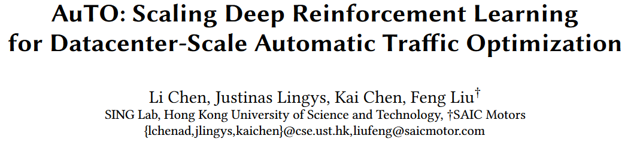
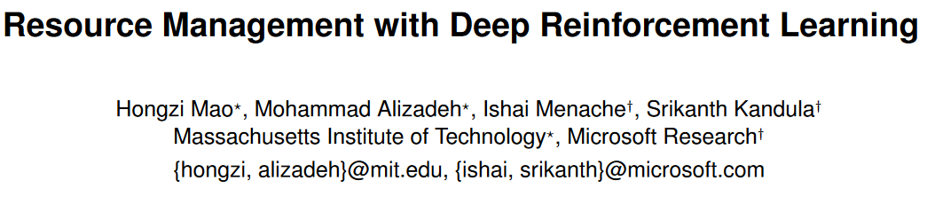
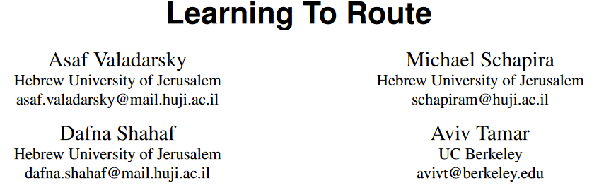
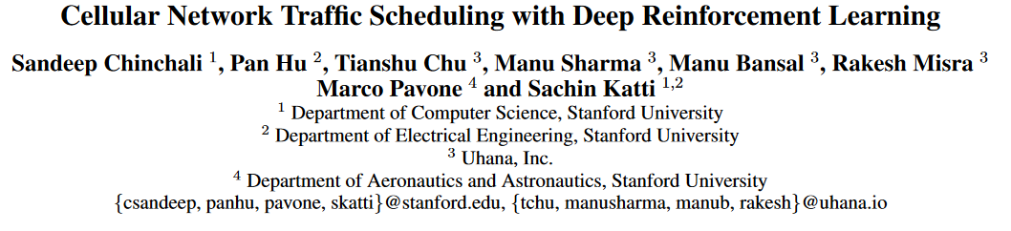
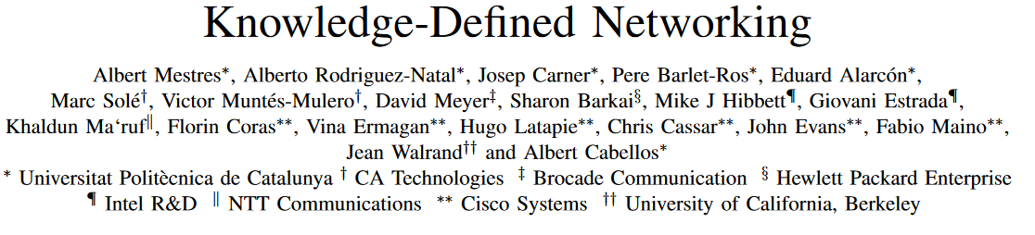
Reinforcement Learning and Networking

Slide 3
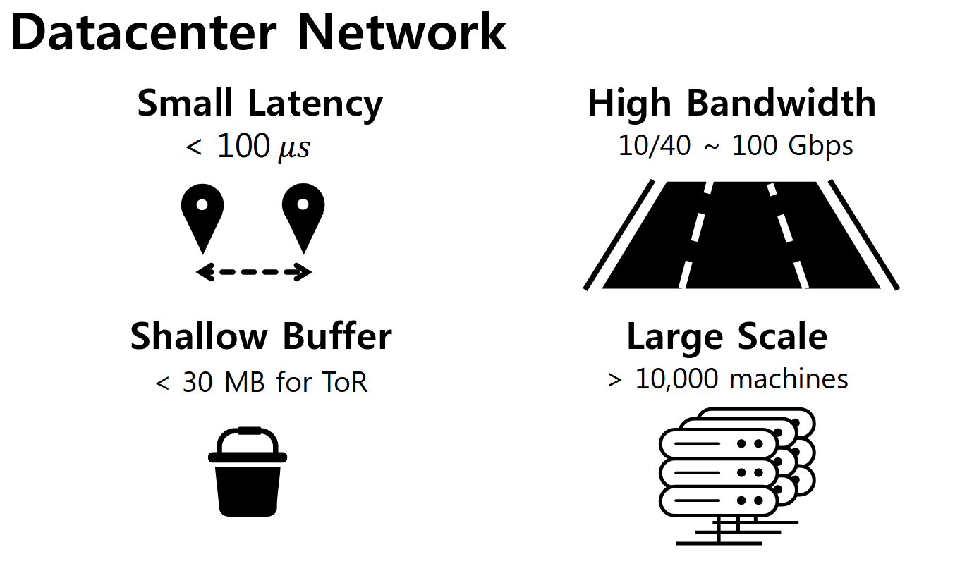
The Data Center: A perfect use case
DC challenges are optimization problems
  Traffic control
  Resource management
  Routing
Operators have complete control
Automation possible
Lots of data can be collected
Cho, Inho, Keon Jang, and Dongsu Han.
"Credit-scheduled delay-bounded congestion control for datacenters.“
SIGCOMM 2017

Slide 4

Two problems…
Typical reinforcement learning is not viable for data center operators!
  Fragile stability
  Questionable reproducibility
  Unknown generalizability
Prototyping RL is complicated
  Cannot interfere with live production traffic
  Offline traces are limited in expressivity
  Deployment is tedious and slow

Slide 5
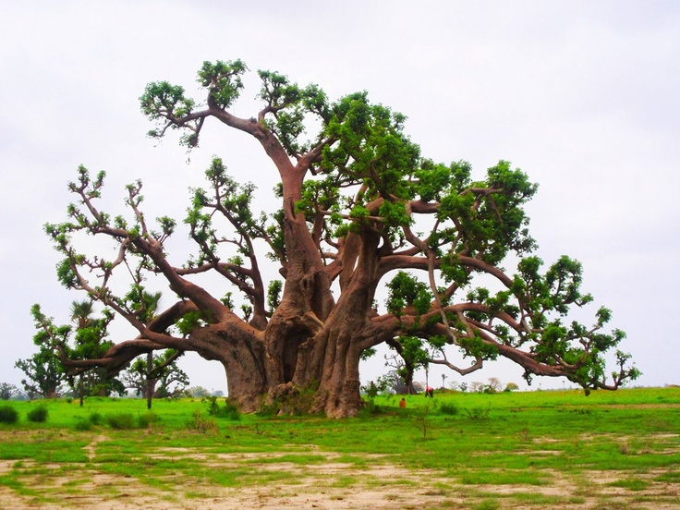
Our work: A platform for RL in Data Centers
  Iroko: open reinforcement learning gym for data center scenarios
    Inspired by the Pantheon* for WAN congestion control
  Deployable on a local Linux machine
    Can scale to topologies with many hosts
  Approximates real data center conditions
  Allows arbitrary definition of
    Reward
    State
    Actions
*Yan, Francis Y., et al. "Pantheon: the training ground for Internet congestion-control research.“ ATC 2018

Slide 6
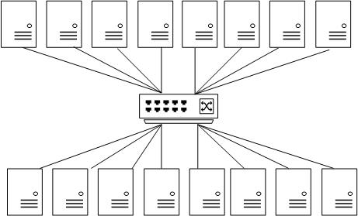
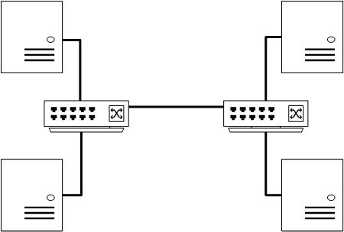
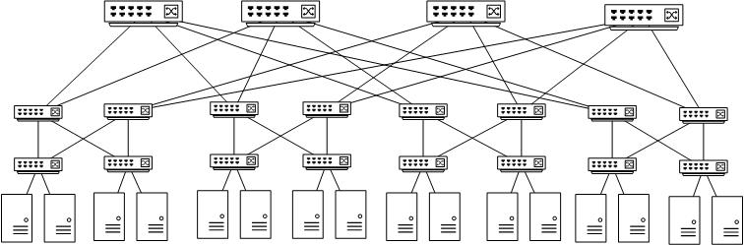
Iroko in one slide
Policy
OpenAI Gym
Reward Model
State Model
Data Collectors
Traffic Pattern
Action Model
Topology
Rack
Dumbbell
Fat-Tree

Slide 7
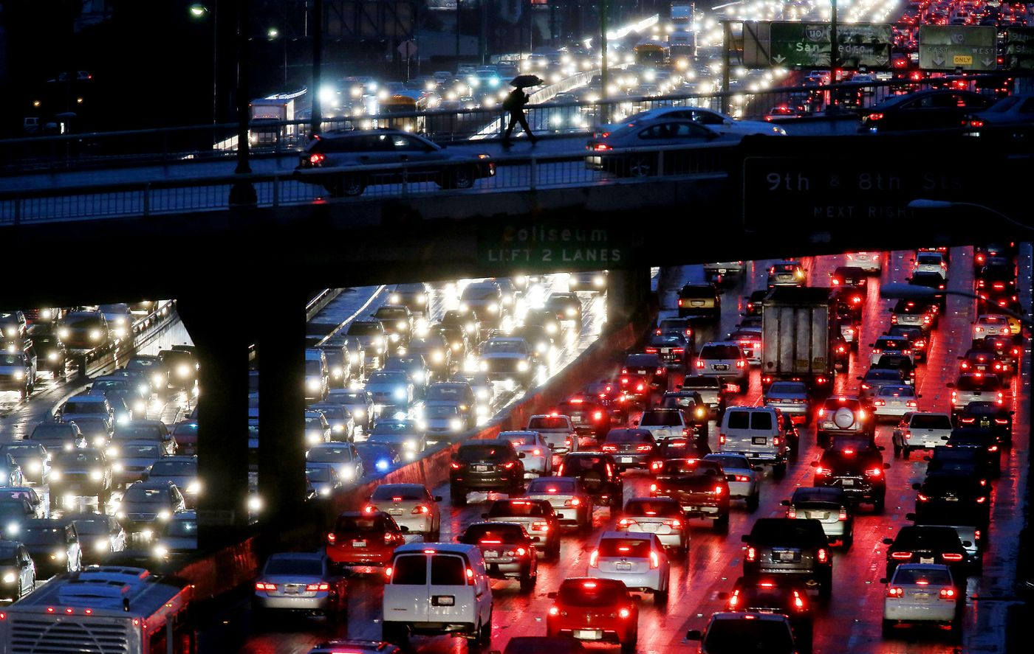
Use Case: Congestion Control
Ideal data center should have:
    Low latency, high utilization
    No packet loss or queuing delay
    Fairness
CC variations draw from the reactive TCP
    Queueing latency dominates
    Frequent retransmits reduce goodput
    Data center performance may be unstable

Slide 8
Predicting Networking Traffic
Bandwidth
Allocation
10
Flow Pattern
Data Collection
Policy
10
10
10
Switch
10
10
10

Slide 9
Predicting Networking Traffic
Bandwidth
Allocation
10
Flow Pattern
Data Collection
Policy
3.3
10
10
10
3.3
3.4
Switch
10
10
10

Slide 10
Predicting Networking Traffic
Bandwidth
Allocation
10
Flow Pattern
Data Collection
Policy
3.3
10
10
Switch
3.3
3.4
10

Slide 11
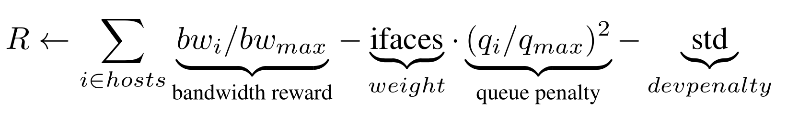
Can we learn to allocate traffic fairly?
Two environments:
  env_iroko: centralized rate limiting arbiter
    Agent can set the sending rate of hosts
    PPO, DDPG, REINFORCE
  env_tcp: raw TCP
    Contains implementations of TCP algorithms
    TCP Cubic, TCP New Vegas, DCTCP
Goal: Avoid congestion

Slide 12
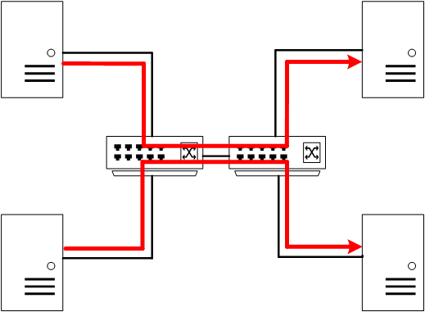
Experiment Setup
50000 timesteps
Linux default UDP as base transport
5 runs (~7 hours per run)
Bottleneck at central link

Slide 13
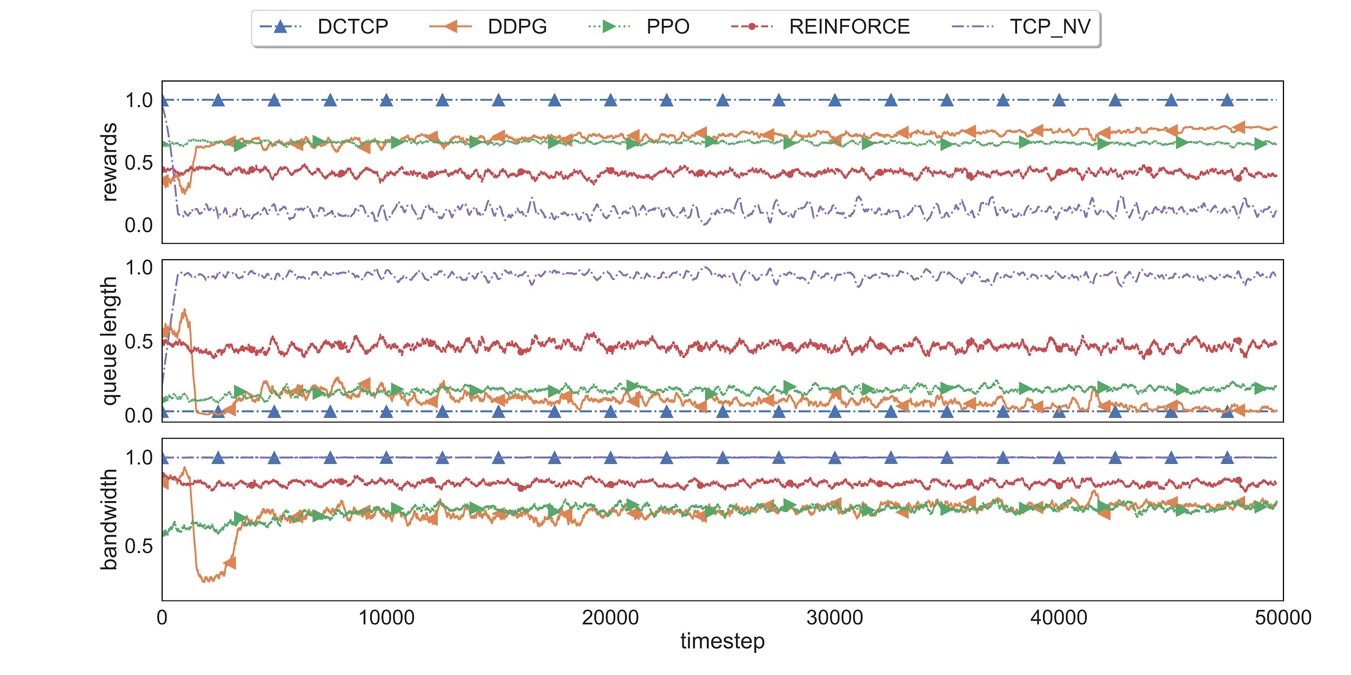
Results – Dumbbell UDP

Slide 14

Results - Takeaways
Challenging real-time environment
  Noisy observation
  Exhibits strong credit assignment problem
RL algorithms show expected behavior for our gym
  Achieve better performance than TCP New Vegas
  More robust algorithms required to learn good policy
    DDPG and PPO achieve near optimum
    REINFORCE fails to learn good policy

Slide 15

Contributions
Data center reinforcement learning is gaining traction
  …but it is difficult to prototype and evaluate
Iroko is
  a platform to experiment with RL for data centers
  intended to train on live traffic
  early stage work
    but experiments are promising
  available on Github:
  https://github.com/dcgym/iroko

