Slide 1
XASM: A Foundation to Program the X2 with P4
Fabian Ruffy, Vladimir Gurevich

Slide 2
Agenda
What is X2 and XISA?
Why XASM?
XASM Concepts
To P4 and Beyond!

Slide 3
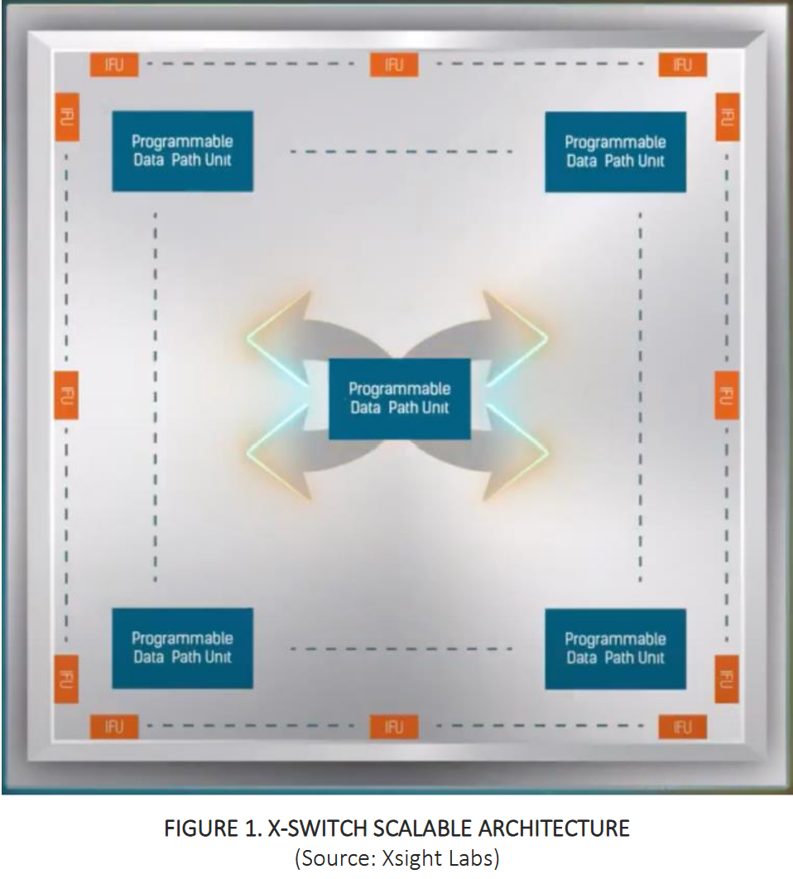
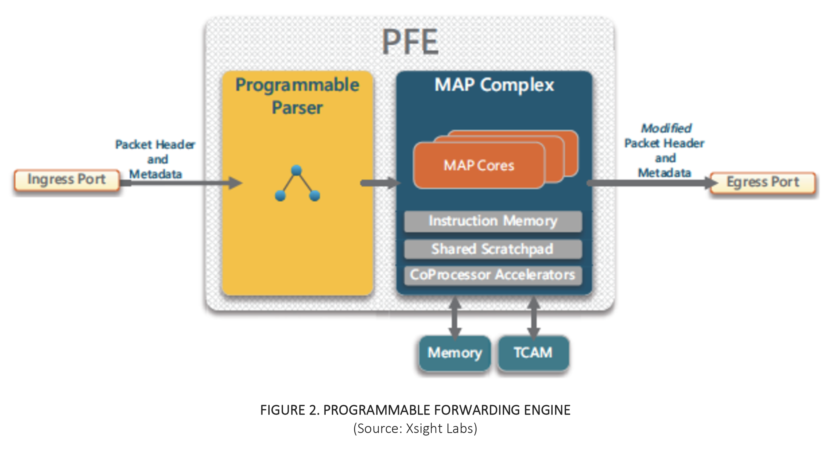
The X2 Switch
12.8Tbps Programmable Switch
  400Gbps/200Gbps/100Gbps ports
  Additional PCIe and Ethernet CPU ports
Ensemble of Data Processing Units (DPUs)
  Programmable Parser
  Programmable Match-Action Processor (MAP)
  Packet buffer, SRAMs, TCAMs
Open Instruction Set Architecture (X^{ISA})
Source: https://xsightlabs.com/wp-content/uploads/2025/03/WN-X-Switch-ISA-WP-Mar2025-1.pdf

Slide 4
Tofino Native Architecture (TNA)
Packet data
Programmable Interfaces
Fixed (intrinsic) interfaces
TNA Switch
Ingress Headers
Ingress Metadata
Egress Headers
Egress Metadata
packet_in
packet_out
packet_in
packet_out
Packet Ingress
Packet Replication
Engine &
Traffic Manager
Packet Egress
Parser
Control
Deparser
Parser
Control
Deparser
Ingress pipeline
Egress pipeline
Straight-through packet flow

Slide 5

X2 Programming Model
Follows P4 Model: Fixed-function core with programmable portions
No fixed compute budget, throughput and latency degrades commensurate with complexity.
Programmable packet flow
X2 Data Plane
Ingress Port
Egress Port
Entry Points
Overall Data Plane Algorithm
Entry Points
Parser
MAP
Packet
Packet
Queue
Manager
ASM
EXTMAP MAPR0, 0, 0, 96
EXTNTXP R3, 96, 16
STHC 14, 3, 1, JUMP_NEXT
ASM
MOV R0.0, R1.3
BRBTSTSET R11.3, 1, do_ipv4
LKPLPM.LF1 R5, R5, NS, NS, R4.4,…
Packet data
Programmable Interfaces
Fixed (intrinsic) interfaces
Data Plane Program

Slide 6
An Open ISA and XASM
P4
XASM
X-ISA

Slide 7
Compiling A Data-Plane Program
Data-plane program
Userland
Device toolchain (Vendor-provided)
Data-plane programming language
Compiler
Assembler
Parser ASM
EXTMAP MAPR0, 0, 0, 96
EXTNTXP R3, 96, 16
STHC 14, 3, 1, JUMP_NEXT
Control plane objects (Tables, etc.)
MAP ASM
BRBTSTSET R11.3, 1, lkp_eth
lkp_eth:
LKP.LF1 R5, R5, NS, NS, 0,…
Microcode (X-ISA)
X2 Data Plane
Parser
MAP
ASM
EXTMAP MAPR0, 0, 0, 96
EXTNTXP R3, 96, 16
STHC 14, 3, 1, JUMP_NEXT
ASM
BRBTSTSET R11.3, 1, lkp_eth
lkp_eth:
LKP.LF1 R5, R5, NS, NS, 0,…

Slide 8
Down The Switch Stack With An Open ISA
Need to write this code manually and keep it in sync!
Parser ASM
EXTMAP MAPR0, 0, 0, 96
EXTNTXP R3, 96, 16
STHC 14, 3, 1, JUMP_NEXT
?
Control plane objects (Tables, etc.)
?
MAP ASM
BRBTSTSET R11.3, 1, lkp_eth
lkp_eth:
LKP.LF1 R5, R5, NS, NS, 0,…
Microcode (X-ISA)
Userland
X2 Data Plane
Parser
MAP
ASM
EXTMAP MAPR0, 0, 0, 96
EXTNTXP R3, 96, 16
STHC 14, 3, 1, JUMP_NEXT
ASM
BRBTSTSET R11.3, 1, lkp_eth
lkp_eth:
LKP.LF1 R5, R5, NS, NS, 0,…

Slide 9
Raw X-ISA Program
X2 Parser Instructions
X2 MAP Instructions
entry_point_ethernet:
EXTNXTP R0, 96, 16
{// Transition Rules
entry_point_ethernet
0x800: entry_point_ipv4, 0, 0
}
STHC 14, 12, 1, 1
HALT
entry_point_ipv4:
EXTMAP MAPR4, 0, 0, 128
EXTMAP MAPR2, 0, 128, 32
STHC 20, 14, 3, 0
HALT
entry_point_trap:
entry_point_loopback:
entry_point_reparse:
entry_point_fwc:
HALTDROP
ingress:
BRBTSTCLR R11.3, 14, not_ipv4_packet
CONCAT.CD R2.2, 0, R1.3, 0, 16
LKPLPM.LF5.R R1.3, R1.3, -1, -1, R2, R2, 0, 4
SYNC.N 32, ipv4_lpm_miss
AQMEG.LF3 R1.0, R1.3
MOVI R1.2, 0
MOVI.CD R0.3, 0
SYNC 8
BRBTSTSET R1.0, 0, aqm_drop
SENDOUT.H R1, R0, 0
not_ipv4_packet:
ipv4_lpm_miss:
aqm_drop:
SYNCALL 255
DROP.H 0
Source: https://xsightlabs.com/wp-content/uploads/2025/04/XISA_Simple_IPv4.pdf

Slide 10
Requirements For Our XDE
1. Make it easy to write data-plane programs and hard to make mistakes.
2. Give the same control/performance as X-ISA.
3. Export the right interfaces to high-level languages.

Slide 11

XASM
NPL
XDP2
P4
Python/Rust/C
XASM Language
Data-plane programming language
Compiler
XASM
Assembler
Headers
struct eth {
bit<48> dst;
bit<48> src;
bit<16> type;
}
Parser
extract_eth:
EXTMAP eth[dst…src]
EXTNTXP eth.type
HALT
Tables
table fwd {
key = { bit<48> dst_mac; }
value = { bit<16> qid; }
}
MAP
ingress:
BRITSTSET hdr_present(eth), lkp_eth
lkp_eth:
LKP fwd.key, fwd.value, fwd
Userland
X2 Data Plane
Parser
MAP
ASM
EXTMAP MAPR0, 0, 0, 96
EXTNTXP R3, 96, 16
STHC 14, 3, 1, JUMP_NEXT
ASM
BRBTSTSET R11.3, 1, lkp_eth
lkp_eth:
LKP.LF1 R5, R5, NS, NS, 0,…

Slide 12
XASM Is Inspired By P4
Symbolic programming: All definitions are in the same place and work together.
Control plane interface is an explicit part of the program.
P4
Constants and Types
typedef bit<48> mac_addr_t;
Tables and Externs
action send(port_id_t port) {…}
Parser Code
action drop() {…}
table ipv4_lpm {
key = {
hdr.ipv4.dst : lpm;
}
mac_addr_t dst;
mac_addr_t src;
bit<16> etype;
}
actions = { send; drop }
state parse_ethernet {
pkt.extract(hdr.eth);
transition
0x0800 : parse_ipv4;
default: accept;
}
}
Control Code
apply {
if (hdr.ipv4.isValid()) {
ipv4_lpm.apply();
}
}
meta.vrf : exact;
header ethernet_h {
select(hdr.eth.etype) {
XASM
Constants and Types
typedef bit<48> mac_addr_t;
Tables and Externs
Parser Code
table lpm ipv4_lpm {
mac_addr_t dst;
mac_addr_t src;
bit<16> etype;
}
parse_ethernet:
MAP Code
header ethernet_h {
key = {
bit<12> vrf : exact;
ipv4_addr_t ipv4_dst : lpm;
}
value = {
bit<8> sw_control;
bit<16> qid;
bit<8> action;
}
EXT ether_r, ether_p
NXTP ether_r.ethertype
MOVMAP ethernet, ether_r
STHC ethernet_h, \
header_id_t.ETHERNET,\
layer_id.L2, \
X2::NEXT_ON_MISS
HALT
LKPLPM.LF0 lpm_key, tbl_val, ipv4_lpm
SYNC.N [LF0], ipv4_lpm_default
MOV lpm_val, tbl_val
CONCAT lpm_key.vrf, port_meta.vrf
nonip
LDSPI lpm_val, ipv4_lpm_default
BRBTSTCLR hdr_valid[hdr_id.IPV4], \
ingress:
nonip: DROP.H 0

Slide 13
XASM: Summary
XASM
General Meta-programming Facilities
Macro-assembler with metaprogramming
Functions, macros, and expressions.
Custom errors, imports, conditionals.
Definitions (types, tables, externs).
The goal for XASM definitions is to…
…to make assembly code more readable.
…to generate control plane APIs.
…to combine all programmable X2 elements.
Types
Tables and Extern Definitions
Container Layouts
Parser and MAP Assembly
Control Plane API
Shared Type Definitions
Used by control plane

Slide 14
From XASM To P4
XASM is still assembly! Assembly is hard.
P4 is our language of choice to support higher-level data-plane programming!
We are building a P4 compiler!
XASM is the foundation for this compiler.
P4
XASM
X2 Data Plane
Parser
MAP

Slide 15
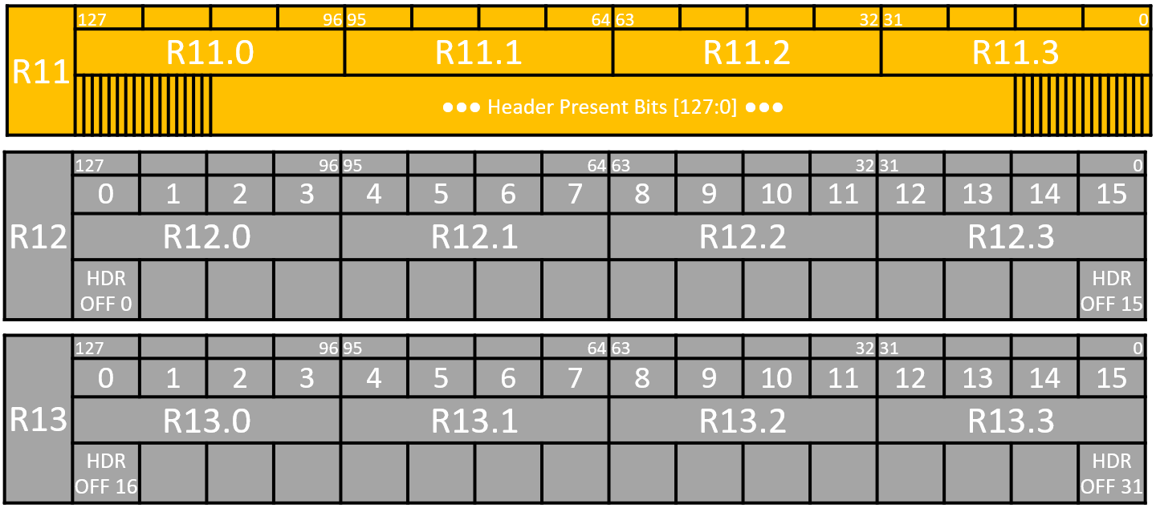
Header Definitions
P4
XASM
typedef bit<48> mac_addr_t;
typedef bit<32> ipv4_addr_t;
enum bit<16> ethertype_t {
TPID = 0x8100,
IPV4 = 0x0800
}
header ethernet_h {
mac_addr_t dst;
mac_addr_t src;
ethertype_t etype;
}
header ipv4_h {
bit<4> ihl;
bit<4> version;
…
ipv4_addr_t src;
ipv4_addr_t dst;
}
header ipv6_h {
typedef bit<48> mac_addr_t;
typedef bit<32> ipv4_addr_t;
enum bit<16> ethertype_t {
TPID = 0x8100,
IPV4 = 0x0800
}
header ethernet_h {
mac_addr_t dst;
mac_addr_t src;
ethertype_t etype;
}
header ipv4_h {
bit<4> ihl;
bit<4> version;
…
ipv4_addr_t src;
ipv4_addr_t dst;
}
enum bit<7> header_id_t { ETHERNET, IPV4, IPV6 };
enum bit<5> layer_id_t { L2, L3 };

Slide 16
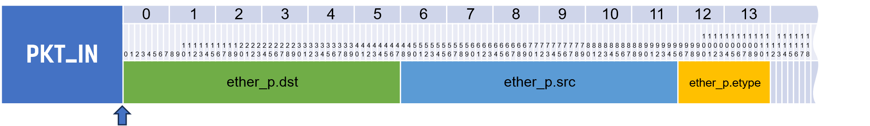
Extracting an Ethernet Header
P4
XASM
struct my_headers_t {
ethernet_h ethernet;
}
parser MyParser(pkt_in pkt,
out my_headers_t hdr, …) {
state parse_ethernet {
pkt.extract(hdr.ethernet);
ethertype_t etype = hdr.ethernet.etype;
transition select(etype) {
ethertype_t.IPV4: parse_ipv4;
default: accept;
}
}
state parse_ipv4 {
pkt.extract(hdr.ipv4);
transition accept;
}
parserdef MyParser {
assembly {
parse_ethernet:
assume ethernet_h ether_p in PKT_IN;
TransitionRules {
ethertype_t.IPv4 -> parse_ipv4;
}
EXTMAP ethernet[.dst:.src], ether_p[.dst:.src]
EXTNXTP.CD ether, ether_p.ethertype
MOVMAP ethernet.ethertype, ethertype
STHC ether_h.size_bytes(), \
header_id_t.ETHERNET, \
layer_id.L2, \
X2::NEXT_ON_MISS
HALT

Slide 17
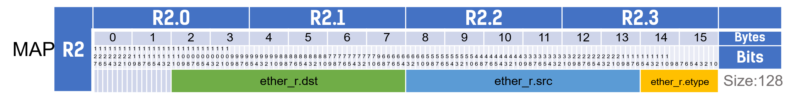
Extracting an Ethernet Header
P4
XASM
struct my_headers_t {
ethernet_h ethernet;
}
parser MyParser(pkt_in pkt,
out my_headers_t hdr, …) {
state parse_ethernet {
pkt.extract(hdr.ethernet);
ethertype_t etype = hdr.ethernet.etype;
transition select(etype) {
ethertype_t.IPV4: parse_ipv4;
default: accept;
}
}
state parse_ipv4 {
pkt.extract(hdr.ipv4);
transition accept;
}
parserdef MyParser {
assembly {
parse_ethernet:
assume ethernet_h ether_p in PKT_IN;
assume ethernet_h ethernet in R2;
TransitionRules {
ethertype_t.IPv4 -> parse_ipv4;
}
EXTMAP ethernet[.dst:.src], ether_p[.dst:.src]
EXTNXTP.CD ether, ether_p.ethertype
MOVMAP ethernet.ethertype, ethertype
STHC ether_h.size_bytes(), \
header_id_t.ETHERNET, \
layer_id.L2, \
X2::NEXT_ON_MISS
HALT

Slide 18
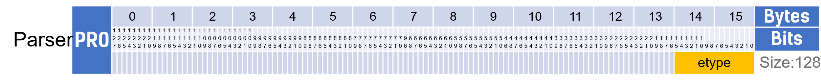
Extracting an Ethernet Header
P4
XASM
struct my_headers_t {
ethernet_h ethernet;
}
parser MyParser(pkt_in pkt,
out my_headers_t hdr, …) {
state parse_ethernet {
pkt.extract(hdr.ethernet);
ethertype_t etype = hdr.ethernet.etype;
transition select(etype) {
ethertype_t.IPV4: parse_ipv4;
default: accept;
}
}
state parse_ipv4 {
pkt.extract(hdr.ipv4);
transition accept;
}
parserdef MyParser {
assembly {
parse_ethernet:
assume ethernet_h ether_p in PKT_IN;
assume ethernet_h ethernet in R2;
assume ethertype_t etype in PR0;
TransitionRules {
ethertype_t.IPv4 -> parse_ipv4;
}
EXTMAP ethernet[.dst:.src], ether_p[.dst:.src]
EXTNXTP.CD ether, ether_p.ethertype
MOVMAP ethernet.ethertype, ethertype
STHC ether_h.size_bytes(), \
header_id_t.ETHERNET, \
layer_id.L2, \
X2::NEXT_ON_MISS
HALT

Slide 19
Extracting an Ethernet Header
P4
XASM
struct my_headers_t {
ethernet_h ethernet;
}
parser MyParser(pkt_in pkt,
out my_headers_t hdr, …) {
state parse_ethernet {
pkt.extract(hdr.ethernet);
ethertype_t etype = hdr.ethernet.etype;
transition select(etype) {
ethertype_t.IPV4: parse_ipv4;
default: accept;
}
}
state parse_ipv4 {
pkt.extract(hdr.ipv4);
transition accept;
}
parserdef MyParser {
assembly {
parse_ethernet:
assume ethernet_h ether_p in PKT_IN;
assume ethernet_h ethernet in R2;
assume ethertype_t etype in PR0;
TransitionRules {
ethertype_t.IPv4 -> parse_ipv4;
}
EXTMAP ethernet[.dst:.src], ether_p[.dst:.src]
EXTNXTP.CD ether, ether_p.ethertype
MOVMAP ethernet.ethertype, ethertype
STHC ether_h.size_bytes(), \
header_id_t.ETHERNET, \
layer_id.L2, \
X2::NEXT_ON_MISS
HALT

Slide 20
Defining a Match Table
P4
XASM
action send(queue_id_t qid) {
if (X2_is_full(qid)) {
X2_drop();
} else {
X2_simple_send(qid);
}
}
action drop() {
X2_drop();
}
table ipv4_lpm {
key = {
meta.vrf : exact;
hdr.ipv4.dst : lpm;
}
actions = {
send; drop;
}
size = 65536;
}
table lpm ipv4_lpm {
key = {
bit<12> vrf : exact;
ipv4_addr_t ipv4_dst : lpm;
}
value = {
bit<1> valid;
bit<7> _; /* Padding */
bit<16> qid;
bit<6> _; /* Padding */
bit<2> action; /* Bit encoded */
}
properties = {
size = 65536;
duplicate = X2::DUPLICATE_TO_ALL;
mem_region = "4x4";
cache_enable = true;
}
}

Slide 21
Match-Action Table Operation
Control Plane
6
7
Headers and Metadata
Header and Metadata Fields
Lookup Key
2
3
Hit
5
1
Key | Action | Action Data
Action Code
Action
Action Data
Hit/Miss Selector
Data
Headers and Metadata
(Input)
Default Action | Default Action Data
Headers and Metadata
(Output)
Action Execution
4

Slide 22
Performing Match-Action Operation
P4
XASM
control MyIngress(inout my_headers_t hdr, …) {
action send() { … }
action drop() { … }
table ipv4_lpm { … }
apply {
. . .
if (hdr.ipv4.isValid()) {
ipv4_lpm.apply();
}
...
}
}
mapdef MyMap {
table lpm ipv4_lpm { … }
Assembly {
assume X2::header_valid_t header_valid in R11;
assume ipv4_lpm::key lpm_key in R3.2..R3.3;
assume ipv4_lpm::value table_val in R3.0;
assume ipv4_lpm::value lpm_val in R3.1;
BRBTSTCLR hdr_valid[header_id_t.IPV4], not_ipv4_packet
CONCAT lpm_key.vrf, port_metadata.vrf 1️⃣
LKPLPM.LF0 lpm_key, table_val, ipv4_lpm 2️⃣
LDSPI lpm_val, ipv4_lpm_default_entry 4️⃣
SYNC.N [LF0], ipv4_lpm_miss 5️⃣
MOV lpm_val, table_val /* This is a hit */ 3️⃣
ipv4_lpm_miss:
JTL.NM lpm_val.action, \ 6️⃣
ipv4_lpm_send, ipv4_lpm_drop, ipv4_lpm_done
ipv4_lpm_send:
…
BRI ipv4_lpm_done
ipv4_lpm_drop:
DROP 0
BRI ipv4_lpm_done
ipv4_lpm_done: 7️⃣
…
not_ipv4_packet:

Slide 23
The Opportunity With the X2: Choice
The open ISA gives you lots of flexibility on the X2 hardware!
Performance scales gracefully.
  Complex data plane code might be slower but always compiles.
  There are many ways to write very efficient code.
How far can we go with P4? We are not sure.
  We are certain about one approach, but there might be others!
  Many P4 architectures can be implemented.
  You can experiment with other languages.
P4
XASM
X2 Data Plane
Parser
MAP

Slide 24
Build X2 Applications With Us!
The X2 is a new programmable switch on the block.
  It has an open ISA!
We want you to experiment or build data-plane programs on the X2!
  We make this easy with XASM.
  We are working on P4 as the first high-level language to program the X2.
When is this software available? Stay tuned…
  Talk to us! fabianr@xsightlabs.com, vladimirg@xsightlabs.com

