Slide 1



p4testgen: Automated Test Generation for Real-World P4 Data Planes
Fabian Ruffy (Intel/NYU), Jed Liu (Akita Software),
Volodymyr Peschanenko (LitSoft), Vladyslav Dubina (LitSoft),
Havel Vojtěch (Intel), Prathima Kotikalapudi (Intel), Anirudh Sivaraman (NYU), Nate Foster (Intel/Cornell University)

Slide 2


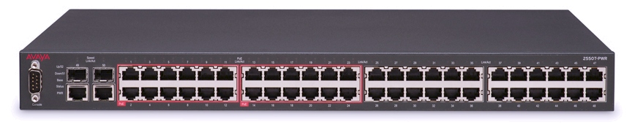

How Do We Test Network Hardware?
Test
specification
Expected output
OK
Control plane configuration
Correct?
Packet input
Network Device
Packet output
Bug

Slide 3
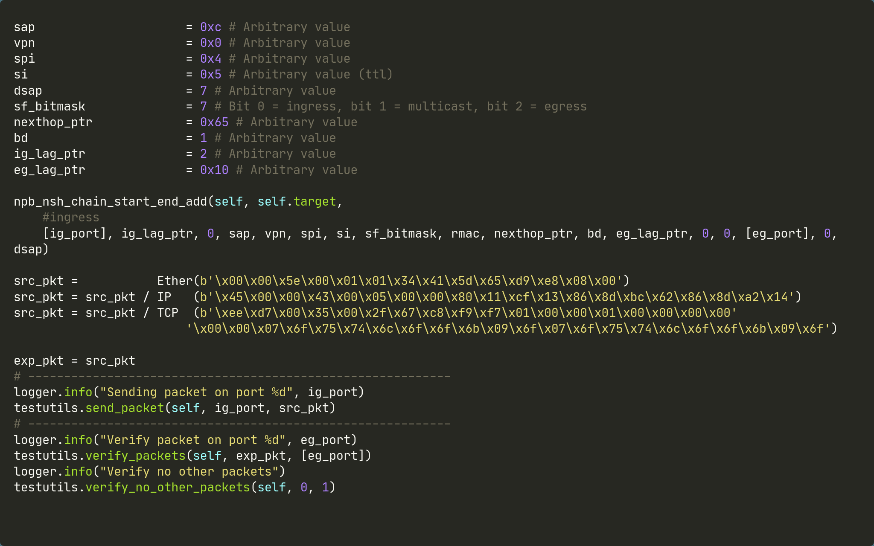
Reality

Slide 4
The Problem With Manual Testing
% of program
covered
?
Return of investment for a test is unclear
What does this test actually cover?
Have we covered enough?
Writing packet tests is hard
Inputs are sequences of bits
Tedious boilerplate required to test a single feature
Tests written
We do not write that many end-to-end tests for network equipment
This is also true for programmable networks!

Slide 5



We Can Do Better
P4 gives a machine-readable contract on how the network device will behave
We have full access to the P4 source code and its semantics
We also know how the target device interprets P4 code
Rich body of software engineering research and formal methods exists
Let’s automate testing!

Slide 6

Idea: Generate Tests With Symbolic Execution
Walk a random path through the P4 program
Collect up a symbolic path constraint
Encode the constraint as a first-order logic formula
Use an SMT solver to find a model (if it exists)
Convert the model into an input and output test
Emit the test and the associated program trace
𝞅

Slide 7
Two Conflicting Requirements
Do not tailor to a target device
(Tofino, eBPF/XDP, BMv2, IPU…)
Model whole program semantics
(How does the HW actually interpret the P4 code?)
No existing tool bridges this gap!

Slide 8
p4testgen
Target-independent
Designed to support test case generation for any P4 target
Anyone can add their own target as an extension (we can reuse code!)
Whole program semantics
Covers the semantics of the P4 program and the device that executes the program
Implicitly models the device specification for single packet tests
Generates inputs and outputs
p4testgen not only checks crashes, but also semantically incorrect behavior

Slide 9
p4testgen: Example
Generated test
parser parser(...) {
pkt.extract(hdr.eth);
}
control ingress(...) {
action set_output_port(bit<9> out) {
meta.output_port = out;
}
table forward_table {
key = { h.eth.src: exact; }
actions = { noop; // default action
set_output_port; }
}
h.eth.src = 48w1;
forward_table.apply();
}
control deparser(...) {
pkt.emit(hdr.eth);
}
Required input
Input port
$input_port
Input packet
$eth.dst ++ $eth.src ++ $eth.type
++ $payload
Required control plane configuration
Table key
48w1
Chosen action
“set_output_port”
Action argument
$out
?
Expected output
Output packet
$eth.dst ++ 48w1 ++ $eth.type
++ $payload
Output port
$out

Slide 10
p4testgen: Example - Solved
Generated test
What if the packet is too short?
parser parser(...) {
pkt.extract(hdr.eth);
}
control ingress(...) {
action set_output_port(bit<9> out) {
meta.output_port = out;
}
table forward_table {
key = { h.eth.src: exact; }
actions = { noop; // default action
set_output_port; }
}
h.eth.src = 48w1;
forward_table.apply();
}
control deparser(...) {
pkt.emit(hdr.eth);
}
Required input
Input port
9w0
Input packet
48w0 ++ 48w0 ++ 16w0
++ 1500w0
hash(h.eth.dst, out);
Required control plane configuration
What if this is a hash function?
What if this is a hash function?
Table key
48w1
What if this table does not match?
Chosen action
“set_output_port”
Action argument
9w2
Expected output
Output packet
48w0 ++ 48w1 ++ 48w0
++ 1500w0
Output port
9w2

Slide 11

The Road to Whole Program Semantics

Slide 12
Challenge 1 - Semantics for the Entire Pipeline
P4 programs only describe the programmable blocks of the target
How can we know what happens in-between these blocks?
Semantics defined by P4 program
?
Parser
?
Control
?
Deparser
?
Semantics defined by target

Slide 13
Solution 1 - Architecture Model
Architecture description
Parser
Each target must describe an architecture model
Packets can be dropped, recirculated, or modified
Current architecture model is a C++ DSL
Converted into custom control flow (right)
We are planning to model this in P4 going forward
Reusable
Common code can be reused across targets
$parser_error == true?
Control
$drop == true?
$recirculate == true?
Deparser
Drop
packet
Emit packet
at $port
Technical detail: We use continuations to implement this model

Slide 14
Challenge 2 - Avoiding Unreliable Tests
Some program state is undefined or random
We have no control over this state, and we can not know the generated output
What to do when a table reads on an uninitialized key field? How can we know we match?
Not all target functions (externs) can be modelled using first-order logic
Expressing hash functions is difficult and solving them can be very slow
But we still need a concrete mapping to avoid producing unreliable tests

Slide 15
Solution 2.1 - Taint Tracking
Mark state affected by unreliable program segments tainted
E.g.: An assignment that reads from an uninitialized variable will taint the destination
Resolve tainted reads as needed:
Either further propagate taint or resolve taint directly at the program node
E.g.: An if statement with a tainted condition could execute either branch
When generating a test…
Use “don’t care” settings for unreliable outputs (e.g., tainted segments of the output packet)
Discard the test wherever we have no choice (e.g., tainted output ports)

Slide 16
Solution 2.2 - Concolic Execution
We could mark complicated externs tainted, but this will cause taint explosion
Use concolic execution instead
Approach
Pick a set of random inputs for the function
Calculate the function output using these inputs
Encode these inputs and outputs as constraints for the SMT solver
Check whether the solver can find a model
Yes? Done.
No? Try again or abandon this particular branch.

Slide 17
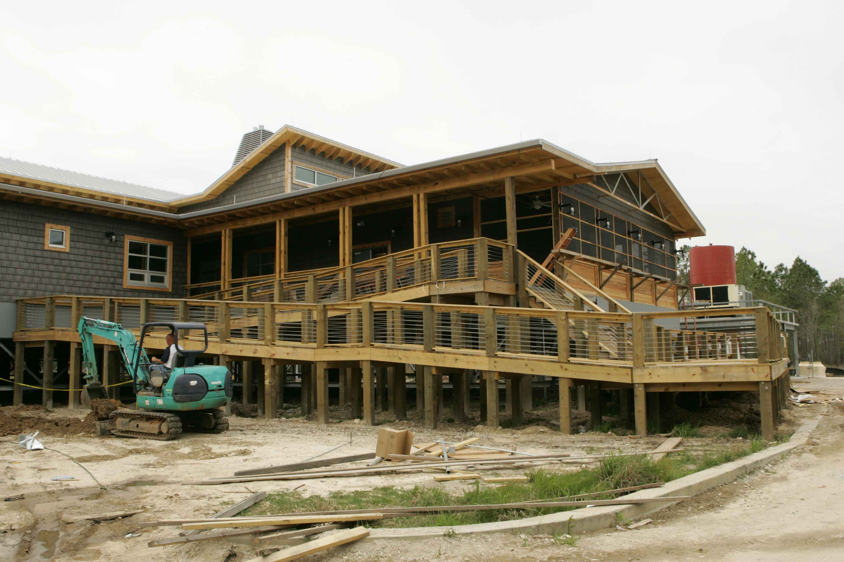
Current Status

Slide 18
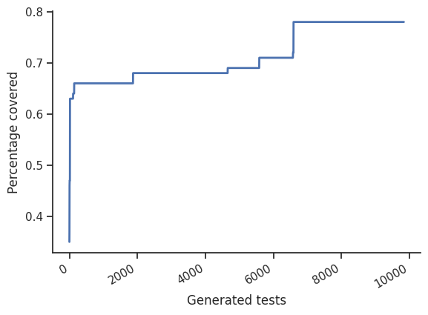
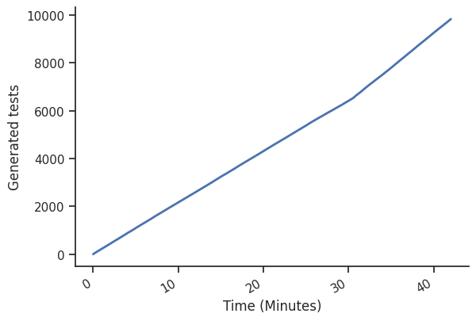
p4testgen: PINS Case Study
Ran p4testgen on a P4 model of a fixed-function switch
Part of the P4 Integrated Networking Stack (PINS)
We cover all reachable statements in the program
Many branches are hidden within extern execution (e.g., extract)
Coverage over time
Test case generation per minute

Slide 19
p4testgen: Technical Details
p4testgen is written as a back end for P4C – the P4 reference compiler
Uses P4C’s visitor framework to implement the interpreter
p4testgen benefits from improvements to P4C
p4testgen currently supports test generation for the Tofino and BMv2 targets
Goal is to implement the full device specification for single packet tests
Also includes end-to-end testing scripts
p4testgen supports the packet/simple test framework (PTF/STF)
Other test frameworks can easily be added

Slide 20
p4testgen: Limitations
We only generate single packet tests
No load testing
Can not check for race conditions or timing issues
Can not check for runtime issues with shared register state or memory writes
No control over metadata or state
This is purely an implementation problem. HW target may not support this
No silver bullet
Target developers still need to spend time to implement the device specification

Slide 21
Who Can (Or Should) Use p4testgen?
Compiler developers can use p4testgen to…
…prototype new back ends
Device manufacturers can use p4testgen to…
…specify the desired behavior of the target device and validate execution
Resellers/vendors can use p4testgen to…
…certify they are compliant with the manufacturer and P4 specification
Device users can use p4testgen to…
…automatically generate validation tests for their P4 programs

Slide 22
Disclaimer
Intel technologies may require enabled hardware, software or service activation.
No product or component can be absolutely secure.
Your costs and results may vary.
© Intel Corporation. Intel, the Intel logo, and other Intel marks are trademarks of Intel Corporation or its subsidiaries. Other names and brands may be claimed as the property of others.

Slide 23
Thank You
Contact:
Fabian Ruffy – fruffy@nyu.edu
Nate Foster – nate.foster@intel.com

Slide 24
Challenge 1 - Flexible Semantics for P4
Three requirements
p4testgen must be an oracle for the P4 language
Should not worry about P4 semantics when writing a p4testgen extension
p4testgen must be as broad as the P4 language specification
Leave room for target-specific behavior (e.g., drop packet when certain metadata is set)
We must be able to stop/resume execution
We want to continue generating tests after we have completed one branch
We also want to use different test generation strategies and easily switch branches

Slide 25
Solution 1 - The P4 Abstract Machine
Convert P4 code into tree of program nodes
Walk each branch and builds program state
Emit test at each leaf node, then backtrack (Depth first)
State is fully independent
Can easily switch between program branches
Every node can change subsequent program execution
Target extensions can implement their own control flow
Target can change the semantics of every program node (Tables!)
Technical detail: We use continuations to implement this model
Parser
Control
Table
Action1
NoAction
Deparser
Program nodes

