Slide 1
Incremental Specialization of Network Programs
Fabian Ruffy, Zhanghan Wang (New York University),
Gianni Antichi (Politecnico di Milano),
Aurojit Panda, Anirudh Sivaraman (New York University)

Slide 2
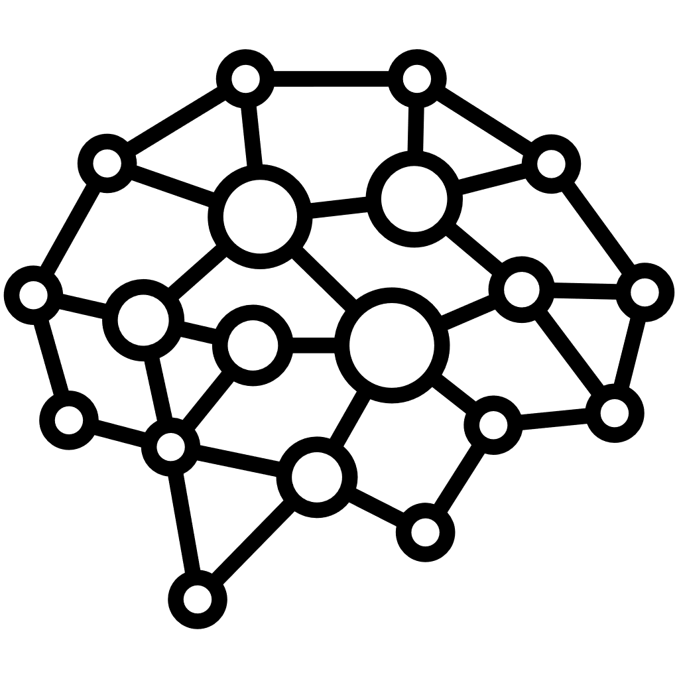


Specializing Network Devices
Control plane
Program
Optimizing compiler
Control-plane API
Packets
Parse IPv6
Forward
Parse Ethernet
Drop
Parse IPv4
Tunnel
Programmable network device

Slide 3

Specializing Network Devices
ESwitch (SIGCOMM’16)
HODA (EuroSys’24)
Morpheus (ASPLOS’22)
Pipeleon (SIGCOMM’23)
Control plane rules
CPUs: fewer branches and instructions!
Switch ASICs: space for other NFs!
FPGAs: a little bit of both!
Control plane
Program
Specialization inputs
Optimizing compiler
Specializing compiler
Traffic workload
Control-plane API
Packets
Parse IPv6
Forward
Parse Ethernet
Drop
Parse IPv4
Tunnel
Programmable network device

Slide 4


Your Optimization Inputs Can And Will Change
  Degree of Staleness
Insert drop rules!
Resolving program staleness
Control plane
Program
Specialization inputs
Specializing compiler
Control-plane API
Respecialize on
every update
Respecialize in
fixed intervals
Packets
Parse IPv6
?
Forward
Parse Ethernet
Drop
Incremental respecialization (only when necessary)
Your program is stale!
Programmable network device

Slide 5
Three Observations We Can Use To Our Advantage
Traffic workloads are measured. Control-plane configurations are defined.
Many control-plane updates are only targeting a specific program element.
Many control-plane updates don’t affect semantics in your source program.

Slide 6


Incremental Specialization
Control plane
Update: “Remove all drop rules”
Specialization shim
Specialization inputs
Compiler
Recompile
Behavior change?
Affected?
ACL
ACL
ACL*
  Network device program
Parser
Tunnel

Slide 7
Does Incremental Specialization Work?
We implemented partial evaluation for P4.
Dead code removal, constant substitution, table inlining.
Control-plane specialization can already save resources.
Our analysis saved 20% stages on a SCION Tofino program.
The specialization is incremental.
We process profile updates and make a decision within 100ms.
There are challenges and limitations course!
Please see our paper for implementation details.

Slide 8

Where We Are Stuck: The Ecosystem Is Not There Yet
Enablers for incremental specialization
Incremental compilation: only recompile the pieces that changed.
Partial reconfiguration: change program modules disruption-free.
Control plane
Specialization shim
Specialization inputs
Compiler
Recompile
A
A
ACL*
  Network device program
Parser
Tunnel

Slide 9
Projects For The Community
Realizing partial reconfiguration and incremental recompilation.
Explore trade-offs between specialization quality and specialization durability.
Apply incremental specialization to the rest of the network.
Consider reintegrating traffic information as optimization input. Reliably!
Project Repository: https://github.com/nyu-systems/flay

Slide 10



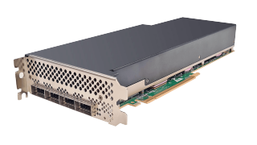

Specialized Networks
Control plane
I only have IPv6/UDP traffic and I only configure GRE, not VXLAN!
Specializer
Programmable data plane
VXLAN
GRE
VXLAN
GRE
TCP
UDP
TCP
UDP
IPv4
IPv6
IPv4
IPv6
Lower
cycle count!
Fewer branches!
VXLAN
GRE
TCP
UDP
Free space
in hardware!
IPv4
IPv6

Slide 11
How Do We Get There?
Control plane
Programmable data plane
Abstractions: we can clearly distinguish the inputs to our network programs.
Flexibility: our network devices are programmable and we can change them.
Methodology: approach how to continuously translate inputs to specialization decisions.

Slide 12
How Can We Deal With Profile Changes?
Introduce a slow, but semantics-preserving fallback path.
😕 Wastes resources and can lead to slow packet processing.
Respecialize unconditionally on every profile change.
😕 Intractable for packet traffic workloads. Thrashing happens on the control-plane side.
Periodically respecialize.
😕 Can lead to profile staleness and needlessly disrupt packet processing.
Is there something better we can do?

Slide 13
What Does Our Specializer Need To Be?
(1) Control-plane-specializing
Applies program optimizations based on a given control-plane configuration.
(2) Online and Incremental
Handles changes to the control plane without recompiling from scratch.
(3) Semantics-aware
Determines whether a control-plane change requires updating the optimized program.
(4) Fast
Processes semantics-preserving control-plane updates as quickly as possible.

Slide 14
How Do We Implement This? Use Partial Evaluation!
Static Input
Data
Program
General program
Partial Evaluator
Specialized P4 Program
Dynamic Input
Output
Static input

Slide 15

Incremental Partial Evaluation
Control-plane input (static)
Data
Program
P4 program
Partial Evaluator
Specialized P4 Program
Packet Input (dynamic)
Packet output (unchanged)
Control-plane input

Slide 16

An Implementation
Rate of change:
Control-plane updates
Once
For details on this implementation, please see our paper!
On every control-plane update
Control-plane assignments
On semantics change
Specialization queries
P4 program
Data-plane expressions
Dead-code elimination
Specialized P4 program
Constant propagation
Table inlining
16

Slide 17
Specializing a P4 Program with Queries
control ingress(Header hdr, bit<9> device_port)
action drop_or_set_port(bool drop, bit<9> port) {
if (drop) {
return;
}
device_port = port;
}
table acl_table {
key = { hdr.eth.src: ternary; }
actions = { drop_or_set_port }
}
apply {
acl_table.apply();
}
}
Dependency graph
Match on acl_table?
device_port = 1;
drop?
device_port:= 1
device_port:= port
Drop packet
Emit packet
device_port = 1;
Constant substitution: Can I replace this variable with a constant?
Table inlining: Can I replace this map lookup or table call with a statement?
Dead-code elimination: Can I remove this piece of code?

