Slide 1
Static Analysis Tools For Network Device Software
Dissertation Defence – Ruffy Fabian – 2025-02-13
Committee:
Gianni Antichi (Polimi), Nate Foster (Cornell),
Aurojit Panda (NYU), Anirudh Sivaraman (NYU), Thomas Wies (NYU)

Slide 2





Thanks
Tao Wang, Jed Liu, Volodymyr Peschanenko, Vladyslav Dubina, Vladimir Still,
Havel Vojtěch, Chris Sommers, Glen Gibb, Vladimir Gurevich, Boris Beylin, Chris Dodd, Prathima Kotikalapudi, Steffen Smolka, Jonathan Dilorenzo, Hari Thantry, Mihai Budiu, Andy Fingerhut, Antonin Bas, Anirudh Sivaraman, Nate Foster, Aurojit Panda, Gianni Antichi

Slide 3


Is Your Network Forwarding Packets Correctly?
Control plane
This talk: Are network devices
working as expected?
Data plane
?
?
?
?

Slide 4

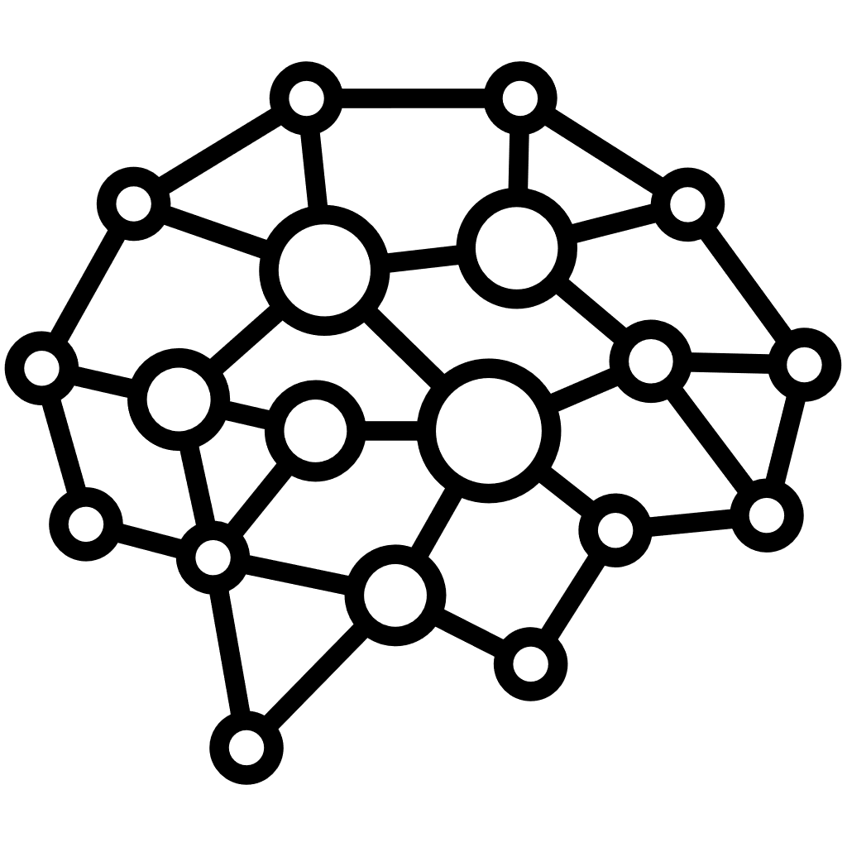
Network Devices Are Increasingly Programmable
Data-plane program
Compiler
Control plane
Control-plane API
Device software
Parsing block
Control block
Forward
Parse IPv6
Packets
Parse Ethernet
Tunnel
Parse IPv4
Drop

Slide 5
Network-Device Software Is Growing In Complexity
Complexity in breadth
Complexity
in depth
P4Runtime
NetCONF
Control plane agent
gNMI
RestCONF
Network/device OS
DENT
ONL
SONiC
Stratum
Device abstraction layer
SAI
TDI
Netlink
IPDK TAI
P4
Restricted C
Microcode
Device DSLs/compilers
NPL
Oxide Rust
Network devices
CPUs (DPDK, eBPF/XDP, Linux TC, OVS, …)
Switches (X2, Intel Tofino, Cisco Silicon One, Broadcom Trident, Juniper Trio, ...)
SmartNICs (NVIDIA BlueField, Marvell Octeon, Intel IPU, AMD Pensando, …)

Slide 6
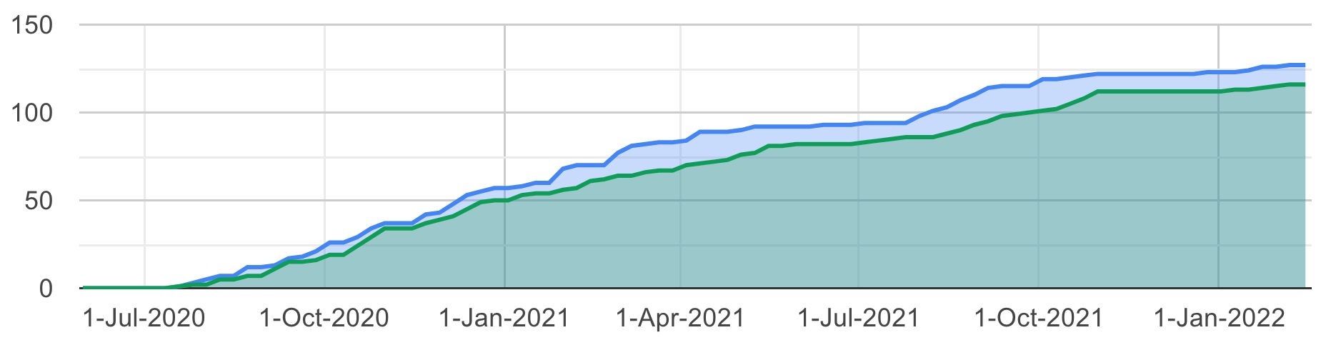
Bugs
Software stack for some
of Google’s switches.
P4Runtime Server
PINS
Switch Software Stack
Orchestration Agent
SyncD
Vendor Abstraction Layer (SAI)
Switch running PINS
ASIC
Drivers
Hardware
Abstraction Layer
Switch Linux
ASIC
CPU
> 10⁷ LOC
filed
We need good tools to handle this complexity
number of bugs
resolved
Bugs found in Google PINS during development (SwitchV, SIGCOMM 22)

Slide 7


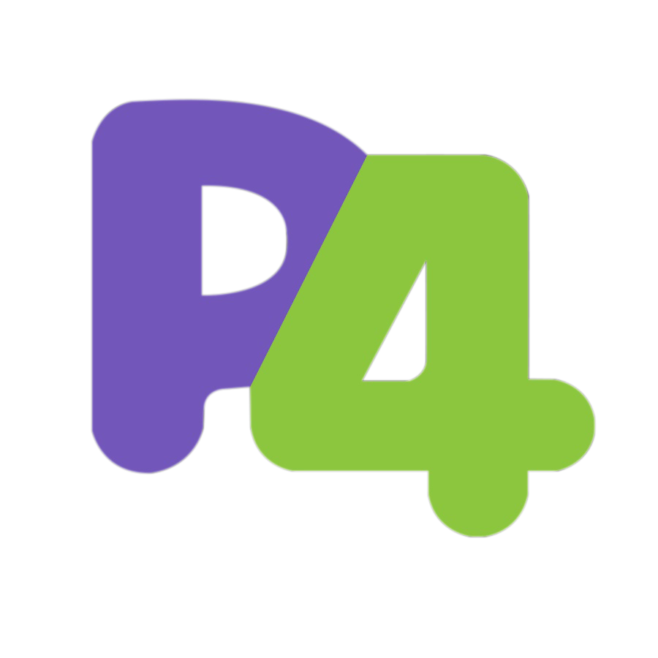
Network Device ≠ General-Purpose Processor
The restriction in these data-plane-programming languages are great for static analysis!
Data-plane programs
prog
Compiler
prog
Control plane
Control-plane API
Device software
Parsing block
Control block

Slide 8
We can use restricted data-plane programming languages to efficiently analyze general network-device software.

Slide 9
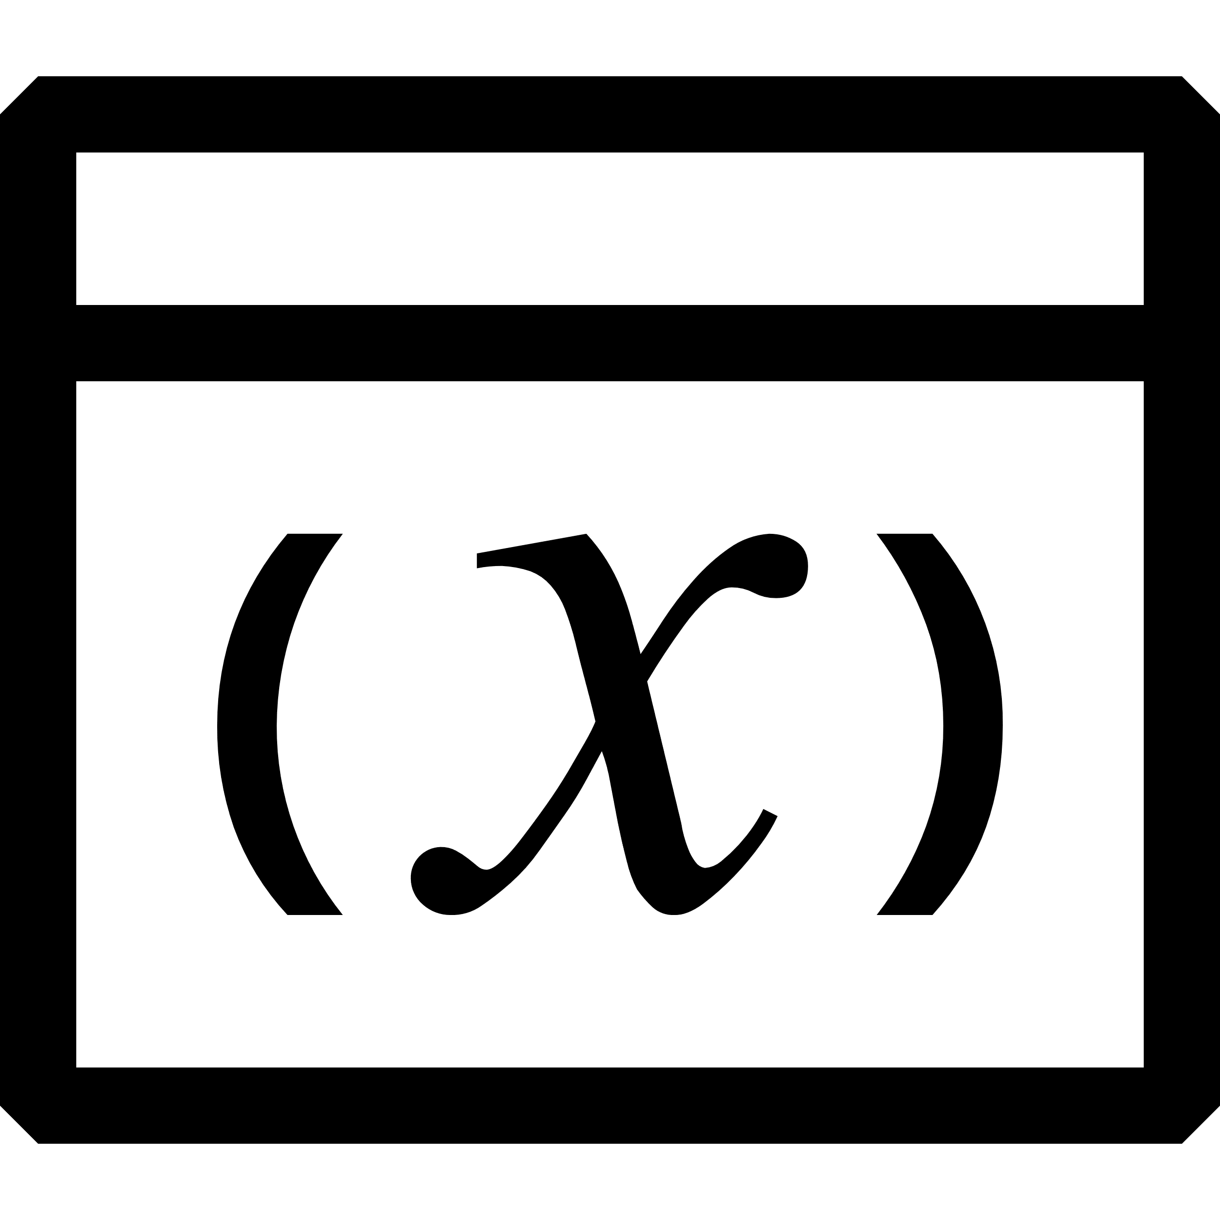
How?
Data-plane program
Execution model
Semantics
Compiler
Control plane
Control-plane API
Device software
Parsing block
Control block

Slide 10
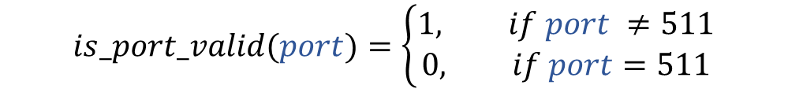
What Do We Mean By “Execution Model”?
Program (Pure Syntax)
Result of the program after “executing” it.
bool is_port_valid(bit<9> port) {
if (port == 511) {
return false;
}
return true;
}
$$is_port_valid(port)=\left\{\begin{aligned}1, if port ≠511 \\ 0, if port=511\end{aligned}\right.$$
We use this representation for static analysis.

Slide 11
How Are We Validating This Model? With Concrete Tools!
Gauntlet: A tool to find bugs programmable network device compilers.
P4Testgen: A packet test-case generator for network devices.
Flay: A framework to specialize network programs to their control-plane config.
Compiler
Control plane
Control-plane API
Device software
Parsing block
Control block

Slide 12

Assumptions And Expectations
Work is all grounded on the P4 data-plane language.
We treat the program as source of truth.
We care about the functional behavior to process a single packet.
No operational semantics.

Slide 13
A P4 Switching Program
Programmable Block
parser parser(Header hdr) {
pkt.extract(hdr.eth); // Classify packet.
}
control ingress(Header hdr, bit<9> output_port) {
action set_port() {
output_port = 1;
}
table port_table {
key = hdr.eth.dst: exact; // Match on Ethernet destination address.
actions = set_port;
}
apply {
// Start execution from here.
output_port = 0;
port_table.apply(); // Match the packet against this table.
}
}

Slide 14
Gauntlet
Model coverage:
Compiler
Control plane
Control-plane API
Device software
Parsing block
Control block
Model inputs:
Data plane program
OSDI 2020

Slide 15


Is The Compiler For Your Network Device Correct?
How can we eliminate bugs in these data-plane compilers?
Data plane program
Parser
Front end
Mid end
Back end
prog.dsl
c
c
Compiler passes

Slide 16

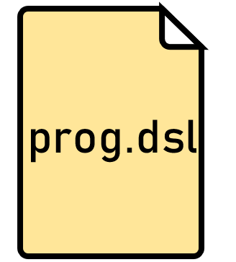

We Try To Find Miscompilations
The compiler does not raise an error, but the compiled program behaves differently.

Slide 17


Our Approach With Gauntlet
We build an SMT-based execution model to check equality of P4 programs.
We use this model to identify more than 30 miscompilations in P4C.

Slide 18

Gauntlet’s Magic: Translation Validation
Equal?
Limited usability for general-purpose languages (too many false positives).
Works great for restricted data-plane programming languages such as P4.

Slide 19
Gauntlet’s Approach: Validating Programmable Blocks
Infer the semantics of each programmable block in our device
Check whether the block’s semantics stay consistent during compilation.
Compiler
Control plane
Control-plane API
Device software
Parsing block
Control block
Semantics defined by data plane program

Slide 20

Gauntlet’s SMT Model For P4
Program
Semantics
Designed for fast SMT solving: Quantifier-free fixed-width bitvectors.
Sources from the data plane (packets) or control plane (tables, maps) are |symbols|.
At each branch point (e.g., if-stmt) we merge state using ternary condition operators:
This only works
because P4 has
a detailed specification.
if (h.eth.type == 0xA)
h.eth_src = 0xB;
else
h.eth.src = 0xC;
h.eth_src:= |h.eth.type| == 0xA ? 0xB : 0xC

Slide 21
How Do P4’s Restrictions Help Us With Our Model?
Restriction | Benefit
Loops are forbidden. | Amount of branching in the program is manageable.
Functions have no side-effects/no aliasing or pointers. | Easy to keep track of changes to state.
Every type is a bitvector. | Can use fast SMT solving techniques.
No arbitrary allocation. | The state we need to track is well defined.
Very little undefined behavior. | Reduces false positives.

Slide 22
Asking An SMT Solver To Find Miscompilations
void set(bit<9> port) {
if (port == 511) {
port = 1;
return;
}
port = 0;
}
Can we find an assignment to |port| where these two programs differ?
|port| == 511?
511 == 511?
1
Yes
No
0
1
Yes
No
0
Dead code
elimination
=/= ?
=/= !
void set(bit<9> port) {
if (port == 511) {
;
return;
}
port = 0;
}
|port| == 511?
511 == 511?
|port|
Yes
No
0
511
Yes
No
0
Assignment removed!

Slide 23
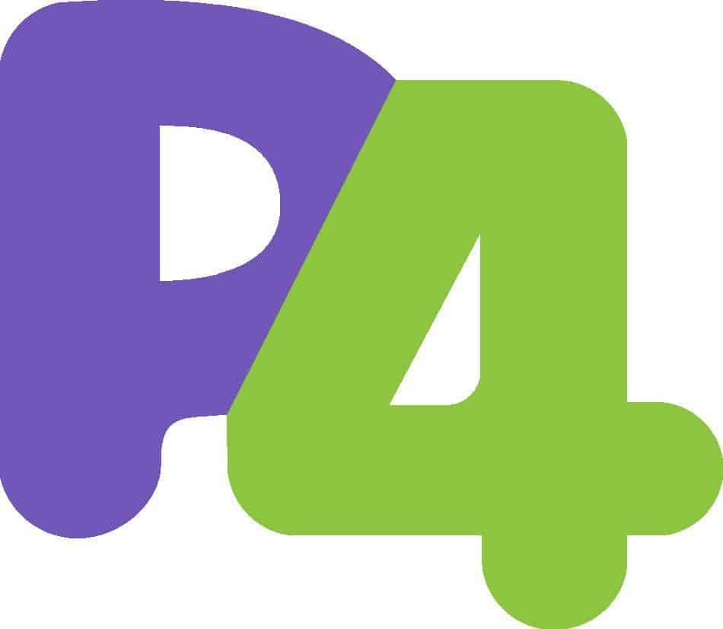


Gauntlet’s Translation Validation Workflow
Produce random
P4 program
Record compiler IR
after each pass
Convert IR Blocks
to SMT
Check
SMT equality
Generator
P4C
OK
Equal?
Miscompilation
Model is robust enough to run this thousands of times on diverse programs…
IR: Intermediate Representation

Slide 24
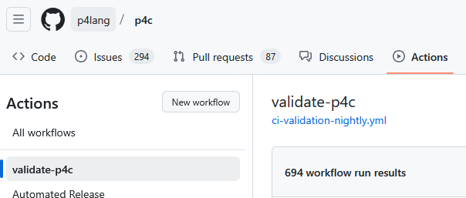
The Effort To Build Gauntlet’s Model Was Non-Trivial
Implemented the full P4 Specification (~180 pages).
Tested on ~600 reference programs + many auto-generated programs.
It took several months to find the first miscompilation with Gauntlet.

Slide 25
Gauntlet: Takeaways
Paying attention to domain restrictions (network programming) pays off.
The SMT-based model for packet-processing can apply to other well-specified network programming languages.
NPL, eBPF/XDP/DPDK frameworks,…

Slide 26
Gauntlet Does Not Check The Whole Software Stack
Gauntlet
Compiler
Control plane
Control-plane API
Device software
Parsing block
Control block
What happens here?

Slide 27
P4Testgen
Model coverage:
Compiler
Control plane
Control-plane API
Device software
Parsing block
Control block
Model inputs:
Data plane program
Device specification
SIGCOMM 2023
+

Slide 28
Reminder: We Want To Improve Our Devices
filed
number of bugs
resolved
Bugs found in Google PINS during development (SwitchV, SIGCOMM 22)

Slide 29

Testing Your Network-Device Software
Test
specification
Program
Expected output
Control plane configuration
OK
Control-plane API
Device software
Correct?
Parsing block
Control block
Packet input
Packet output
Programmable network device
Bug
Fixed network device
Bonus: We can also do this for fixed network devices!

Slide 30
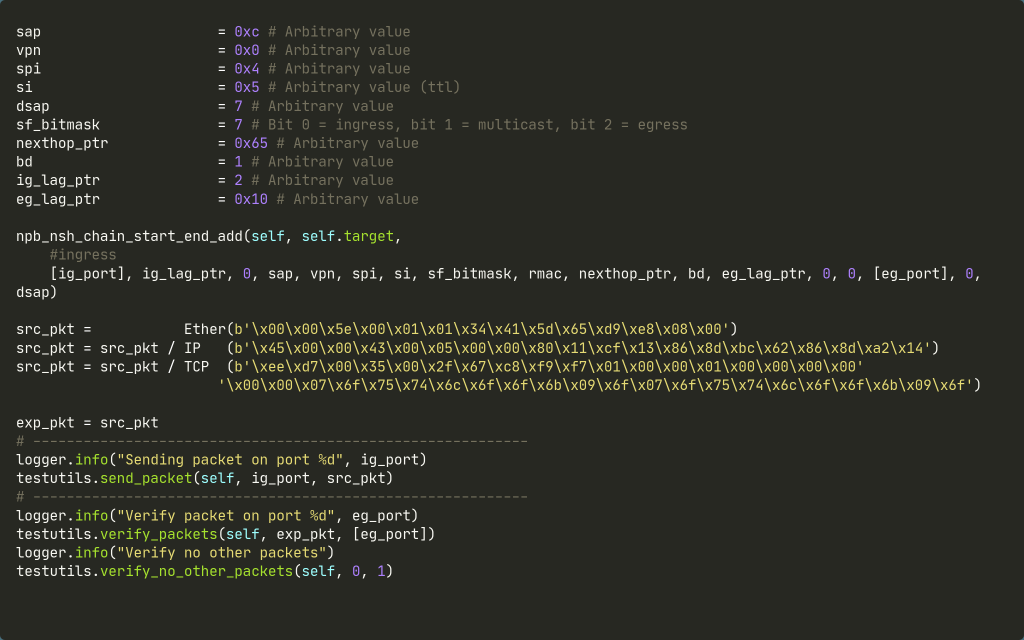

Testing Your Network-Device Software
Control
plane
configuration
We need to write these manually
Test
specification
Program
Expected output
Control plane configuration
OK
% of program covered
?
Control-plane API
Device software
Input/
output
Correct?
Parsing block
Control block
Packet input
Packet output
Programmable network device
Bug
Tests written

Slide 31
A Test Case Oracle: Our Execution Model To The Rescue
Generated Test
Inputs: Expected outputs:
hdr.eth.dst := 1337 hdr.eth.dst := 1337 hdr.eth.src := 0 hdr.eth.src := 0 hdr.eth.type := 0 hdr.eth.type := 0 match_key := 1337 port := 1 match_action := “set_port”
Program
Semantics
Path and constraints
|match_key| == |hdr.eth.dst| &&|match_action| == “set_port”
Take our SMT-based execution model. It’s already an oracle!
Pick an execution path and collect the required data/control plane constraints for the path.
Query SMT solver and retrieve the variable assignments.
Convert assignments into an input/output test; track program coverage.

Slide 32

Generating Exhaustive Single Packet Tests
P4 Switch Model
Control plane
parser parser(Header hdr) {
// Classify packet.
pkt.extract(hdr.eth);
}
control ingress(Header hdr, bit<9> port) {
action set_port() {
port = 1;
}
table port_table {
key = hdr.eth.dst: exact;
actions = set_port
}
apply {
port = 0;
// Look up the destination header.
port_table.apply();
}
}
Packet
Packet
Test 1: Set output port to 1.
Test 2: Do nothing. Drop packet.
Test 3: Send non-ETH packet. Drop packet.
Input packet
Control plane
Packet@Port
Test 1
ETH
set_port
ETH@1
Test 2
ETH
Test 3
XXX
Generated tests

Slide 33
Generating Exhaustive Single Packet Tests
Problem: There is no indication that “0” means “drop” here.
P4 Switch Model
Control plane
parser parser(Header hdr) {
// Classify packet.
pkt.extract(hdr.eth);
}
control ingress(Header hdr, bit<9> port) {
action set_port() {
port = 1;
}
table port_table {
key = hdr.eth.dst: exact;
actions = set_port
}
apply {
port = 0;
// Look up the destination header.
port_table.apply();
}
}
Packet
Packet
Test 1: Set output port to 1.
Test 2: Do nothing. Drop packet.
Test 3: Send non-ETH packet. Drop packet.
Input packet
Control plane
Packet@Port
Test 1
ETH
set_port
ETH@1
Test 2
ETH
Test 3
XXX
Generated tests

Slide 34

Problem: Our Model Does Not Describe Device Behavior
Behavior is described by the network program.
Packets in
Packets out
Parsing block
Fixed block
Control block
Behavior depends on the executing network device.

Slide 35



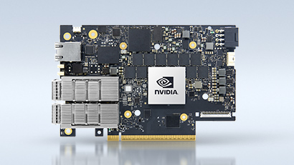




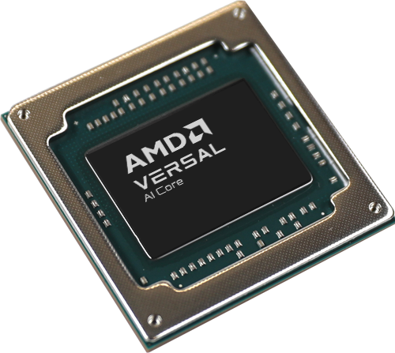

There Are A Lot Of Different Network Devices
Abstract NIC Model
Many test-case oracles to build…
Abstract Switch Model

Slide 36
We Need a Model For Packet-Processing Which…
…is extensible
(not specialized to Tofino, eBPF/XDP, DPDK, SmartNICs…).
…is precise
(Models how the device actually interprets the input program).

Slide 37

P4Testgen bridges this gap!
…is extensible
(not specialized to Tofino, eBPF/XDP, DPDK, SmartNICs…).
…is precise
(Models how the device actually interprets the input program).
Data plane program
Data plane device specification
P4Testgen
Packet input
1010101101011110000011011111001101
Packet output
1010101101011110000011011111001101
Control plane configuration

Slide 38
P4Testgen: Whole-Program Semantics
Challenge | Solution
P4 code does not describe end-to-end behavior. | Pipeline templates.
Device behavior can be underspecified or random. | Taint tracking.
Some functions (hashes) can be too complex for SMT | Concolic execution.
Complex models lead to an explosion in test cases. | Preconditions and path selection strategies.
Detailled descriptions in our SIGCOMM paper.

Slide 39
Whole-Program Semantics: Pipeline Templates
Programmable network devices execute code on well-defined paths.
We can describe these paths using pipeline templates.
Intra-block semantics
Extensions can change the semantics of every program node.
Extensions can define semantics of externs (system calls).
Inter-block semantics
Fills the gaps between the programmable blocks.
Devices can have wildly different control and data flows.
Pipeline Templates
Parser
$parser_error == true?
Control
$drop == true?
$recirculate == true?
Deparser
Drop
packet
Emit packet
at $port

Slide 40
Whole-Program Semantics: Outcome
P4 Switch Model
Decision graph for packet forwarding
parser parser(Header hdr) {
// Classify packet.
pkt.extract(hdr.eth);
}
control ingress(Header hdr, bit<9> port) {
action set_port() {
port = 1;
}
table port_table {
key = hdr.eth.dst: exact;
actions = set_port
}
apply {
port = 0;
// Look up the destination header.
port_table.apply();
}
}
|hdr.eth.parsed|
Yes
No
$port = 0;
|match_key| == |hdr.eth.dst| &&|match_action| == “set_port”
$port = 1;
$port = 0;
$port == 0?
No
Yes
No
Drop
Forward
Legend
P4 semantics
Added by whole-program semantics

Slide 41
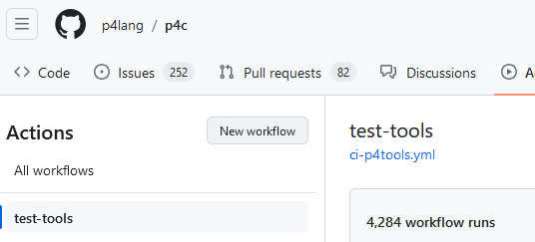

Whole-Program Semantics Make P4Testgen…
…easy to adopt: Aware of at least 7 P4Testgen extensions for network devices.
…sharp: found over 20 bugs in the mature BMv2 and Tofino device software.
…reliable: used by compiler developers, equipment manufacturers, network operators.

Slide 42
Benefits of Whole-Program Semantics: Code Reuse!

Slide 43
P4Testgen: Takeaways
We can capture a lot of network-device behavior using a data-plane language (e.g. P4) as basis.
Your analysis tool should be extensible to handle device diversity well.
Network-specific coverage metrics and queries to produce “interesting” packet tests make tests actually valuable for practitioners.

Slide 44
Flay
Model coverage:
Compiler
Control plane
Control-plane API
Device software
Parser block
Control block
Model inputs:
Data plane program
Device specification
Control plane configuration
HotNets 2024
+
+

Slide 45
Improving Resource Usage Of Network Programs
Improvements here can have an outsized effect!
Network device stack
P4Runtime
NetCONF
Control plane agent
gNMI
RestCONF
Network/device OS
SONiC
DENT
Stratum
ONL
Device abstraction layer
SAI
TDI
Netlink
IPDK TAI
P4
Restricted C
Microcode
Device DSLs/compilers
NPL
Oxide Rust
Network devices
CPUs (DPDK, eBPF/XDP, Linux TC, OVS, …)
Switches (Intel Tofino, Cisco Silicon One, Broadcom Trident, Juniper Trio, ...)
SmartNICs (NVIDIA BlueField, Marvell Octeon, Intel IPU, AMD Pensando, …)

Slide 46
Improving Resource Usage By Specializing Network Devices
Program
Control plane
Compiler
Control-plane API
Device software
Parsing block
Control block
Forward
Parse IPv6
Packets
Parse Ethernet
Tunnel
Parse IPv4
Drop

Slide 47

Improving Resource Usage By Specializing Network Devices
Control plane rules
CPUs: fewer branches and instructions!
Switch ASICs: space for other NFs!
FPGAs: a little bit of both!
Program
Specialization inputs
Control plane
Compiler
Specializing compiler
Control-plane API
Device software
Parsing block
Control block
Forward
Parse IPv6
Packets
Parse Ethernet
Tunnel
Parse IPv4
Drop

Slide 48
We can use our model to generate control-plane configurations, but we can not ingest them!
Our model to generate packet tests
Our model to specialize network programs
Data plane program
Data plane device specification
Data plane program
Data plane device specification
Control plane configuration
Model
Model
Packet input
1010101101011110000011011111001101
Packet output
1010101101011110000011011111001101
Control plane configuration
Specialization decision

Slide 49

Our Approach
Extend our execution model with placeholders for the control-plane.
Represent a control-plane configuration as an assignment to these placeholders.
Specialize by asking queries on this combination.
Rate of change:
Control-plane updates
Once
On every control-plane update
Control-plane assignments
On semantics change
Specialization queries
P4 program
Data-plane expressions
Dead-code elimination
Specialized P4 program
Constant propagation
Table inlining
49

Slide 50
P4 program
action set_port(bit<9> port) {
device_port = port;
}
table acl_table {
key = hdr.eth.src: exact;
actions = set_port
}
device_port = 0;
acl_table.apply();
Decision tree for device_port
|table_configured|
Yes
No
|table_action|
== "set_port"
No
Yes
|port_arg|
0
Initial configuration (Table is not configured)
Control-plane assignment
table_configured: false
table_action: N/A port_arg: N/A
Decision tree for device_port
New P4 program
device_port = 0;
0

Slide 51
P4 program
action set_port(bit<9> port) {
device_port = port;
}
table acl_table {
key = hdr.eth.src: exact;
actions = set_port
}
device_port = 0;
acl_table.apply();
Decision tree for device_port
|table_configured|
Yes
No
|table_action|
== "set_port"
No
Yes
|port_arg|
0
“Insert an entry that matches 0xFFFFFFF on hdr.eth.src and sets the port to 1.”
New P4 program
action set_port(bit<9> port) {
device_port = 1;
}
table acl_table {
key = hdr.eth.src: exact;
actions = set_port
}
device_port = 0;
acl_table.apply();
Control-plane assignment
table_configured: true
table_action: |hdr.eth.src| == 0xFFFFFFF ? “set_port” : N/A port_arg: |hdr.eth.src| == 0xFFFFFFF ? 1 : N/A
|hdr.eth.src| == 0xFFFFFFF
Decision tree for device_port:
1
Yes
No
0

Slide 52
Specialization Has Been Done Before – What’s Different?
We can quickly react to changes!
Use term/e-matching to perform fast expression substitution/simplification.
Substituted expressions
P4 program
Data-plane expressions
Control-plane assignments
Control-plane update
Rate of change
Once
On every control-plane update
52

Slide 53
Incremental Partial Evaluation For Data-Plane Programs
Control plane
Update: “Remove all drop rules”
Specialization inputs
Specializing compiler
Behavior change?
Recompile
Affected?
ACL
ACL
ACL*
Network device program
Parser
Tunnel

Slide 54
Does Our Flavour Of Incremental Specialization Work?
Control-plane specialization can already save resources.
Our analysis saved 20% stages on a SCION Tofino program.
The specialization is incremental.
We process profile updates and make a decision within 100ms.
If you are interested in how we make us this model for incrementality, please see our HotNets 24 paper.

Slide 55
Outlook
Compiler
Control plane
Control-plane API
Device software
Parser block
Control block
Data plane program
Device specification
Control plane configuration
+
+

Slide 56
Our Model
Data plane program
Device specification
Control plane configuration
+
+
Protocol-independent.
Device-agnostic.
Precise for bug finding and program optimization.

Slide 57
What’s Next?
Data plane program
Device specification
Control plane configuration
+
+
Testing for network-device software
Optimizing network device software
Common analysis toolchains for network-device software
Finding more bugs in data-plane compilers
Metamorphic testing
Equivalence modulo inputs
Better compiler optimization
Superoptimization
Credible compilation
Program synthesis
Extend coverage of tooling to eBPF/XDP/DPDK.
Develop models for RFCs
Extending Flay to cover more network-device software
Testing network-device software
Mutation testing
Property-based testing
Develop a general interpreter for P4

Slide 58
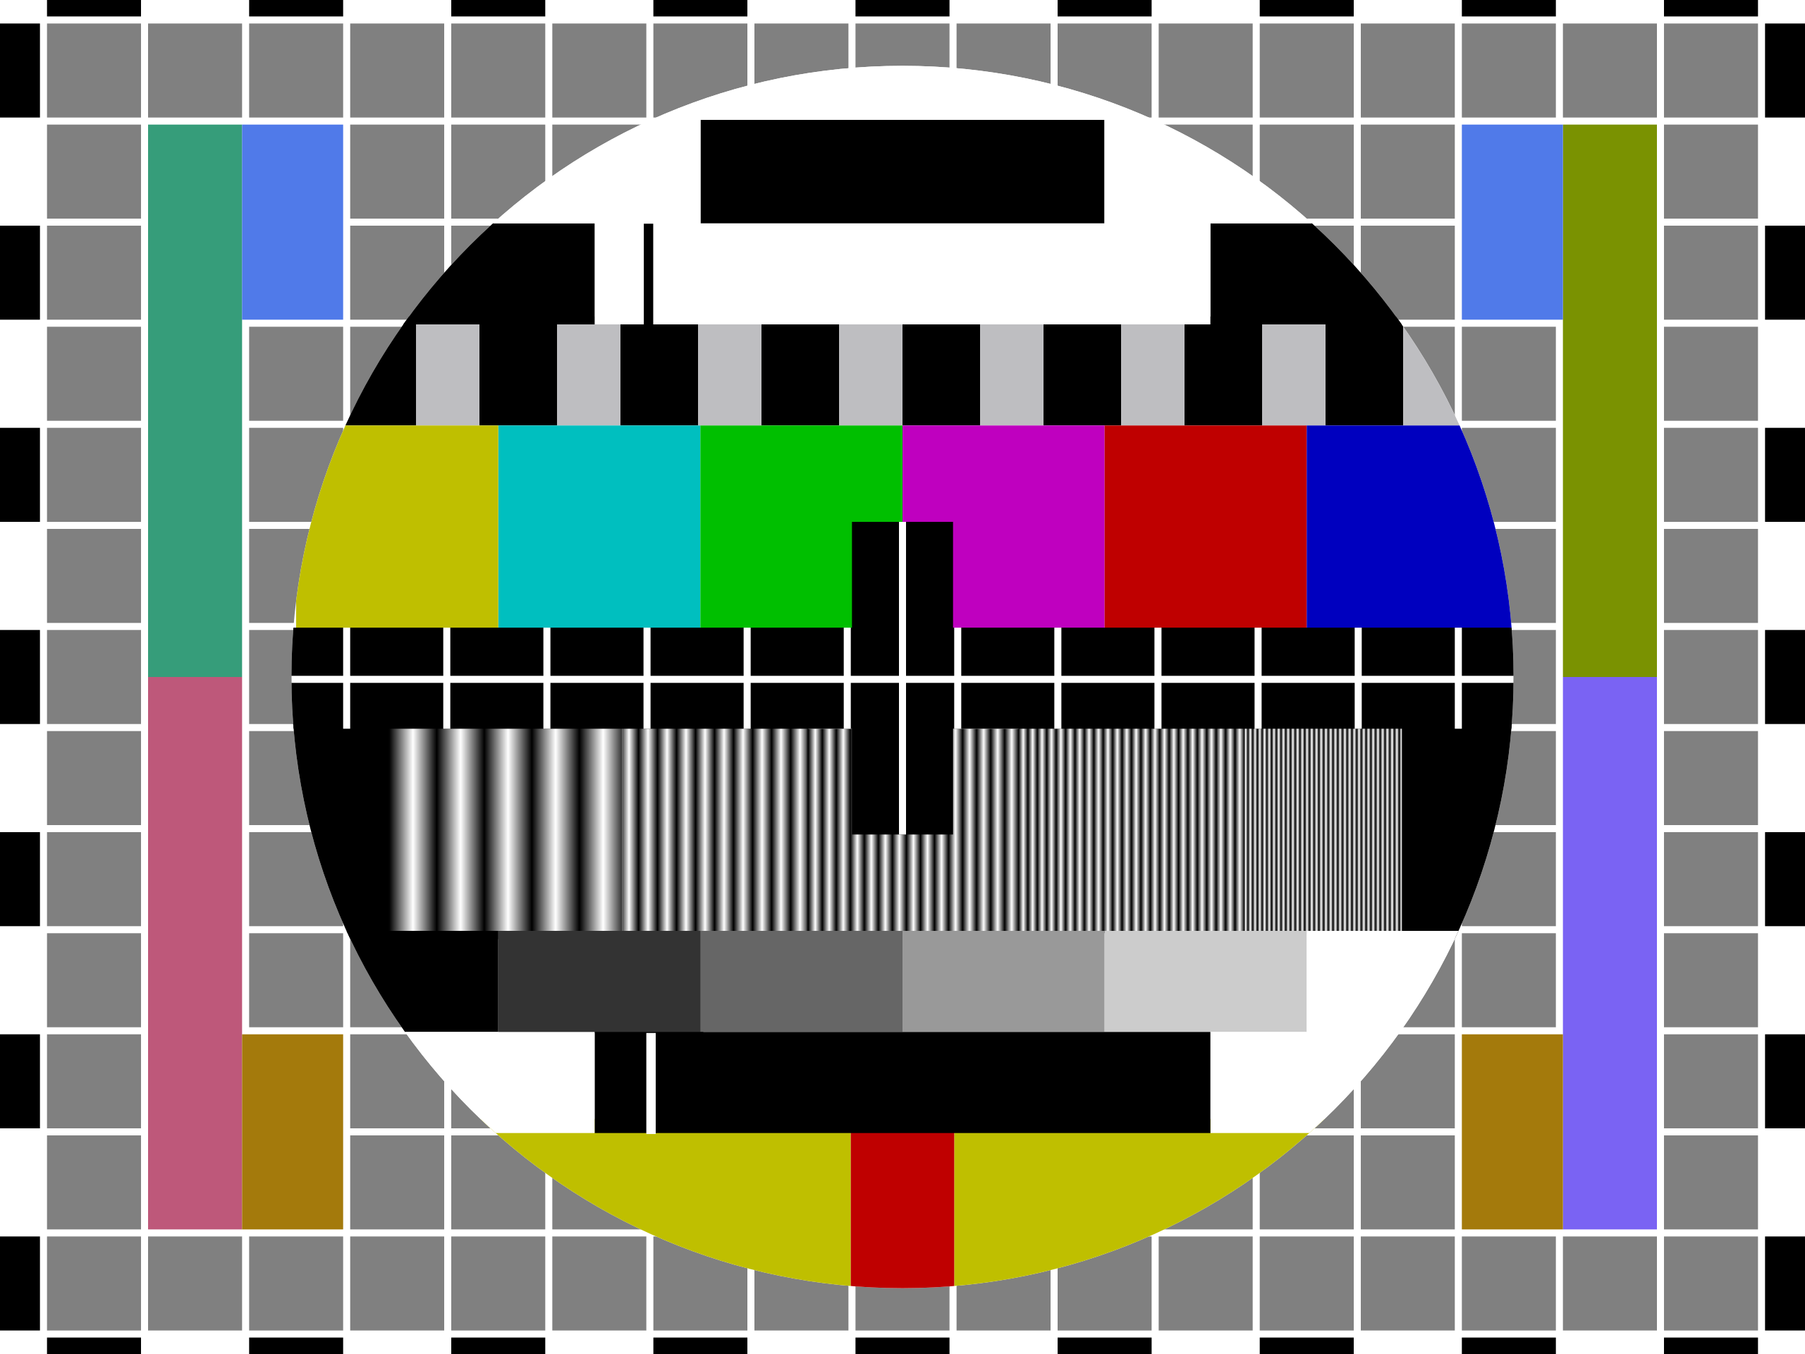

Slide 59
P4Testgen: Bugs Detected in Network-Device Software
Bug Type | Bug Cause | BMv2 | Tofino | Total
Software Crash | Untested packet path | 2 | 7 | 9
 | Control plane interface | 5 | 1 | 6
 | Untested packet size | 0 | 2 | 2
 | Untested device function | 0 | 1 | 1
Wrong Behavior | Untested packet path | 0 | 5 | 5
 | Control plane interface | 1 | 2 | 3
 | Untested device function | 0 | 1 | 1
Total |  | 8 | 19 | 27

Slide 60
Specializing a P4 Program with Queries
control ingress(Header hdr, bit<9> device_port) {
action drop_or_set_port(bool drop, bit<9> port) {
if (drop) {
return;
}
device_port = port;
}
table acl_table {
key = { hdr.eth.src: ternary; }
actions = { drop_or_set_port }
}
apply {
acl_table.apply();
}
}
Dependency graph
Match on acl_table?
device_port = 1;
drop?
device_port:= 1
device_port:= port
Drop packet
Emit packet
device_port = 1;
Constant substitution: Can I replace this variable with a constant?
Table inlining: Can I replace this map lookup or table call with a statement?
Dead-code elimination: Can I remove this piece of code?

Slide 61
Problem: We Do Not Have Control-Plane Semantics
We are missing a model for the control-plane configuration!
Control plane
We have built an SMT-based model for network devices.

Slide 62
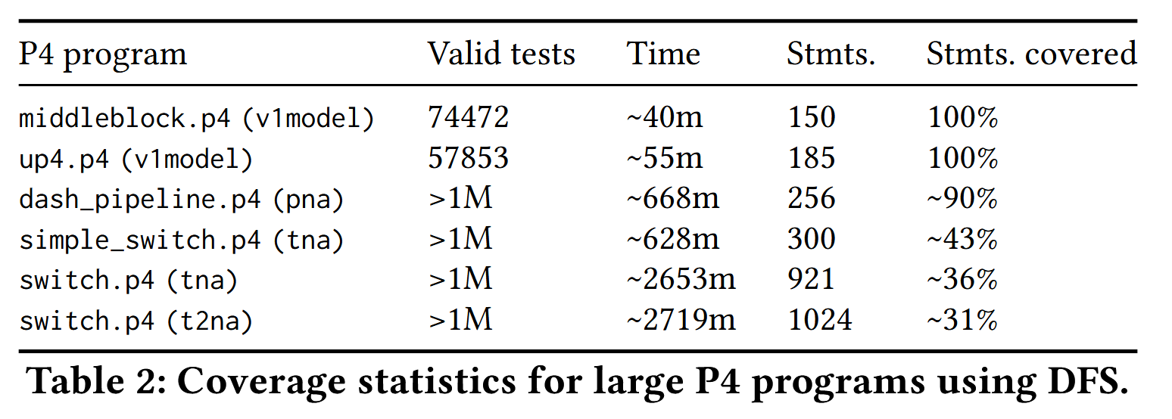
Problem: P4Testgen Generates Tests Exhaustively…
Millions of tests!
Covers less than 50%!

Slide 63

What Is A Good Test?
Do you want to cover all paths/branches/statements in the program?
Do you only want to check for interesting packet sizes and types?
Do you want to test a specific device feature like multicast?
Do you just want any form of assurance?

Slide 64
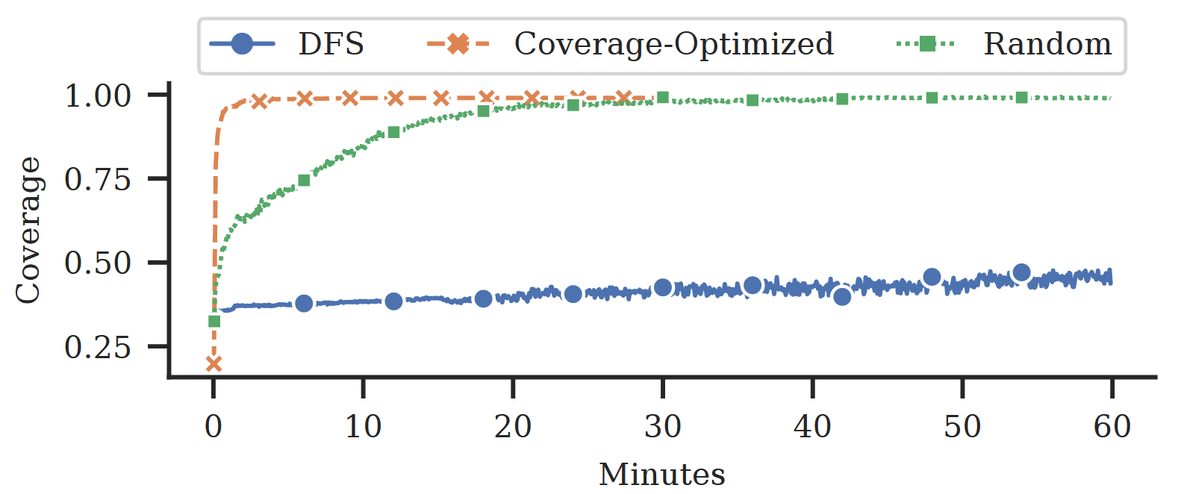
Using Program Coverage To Generate Targeted Tests
We implement path selection strategies to generate targeted tests.
For example: “Cover all the statements/actions/tables in the program.”
100% statement coverage speed for Tofino simple_switch.p4

Slide 65
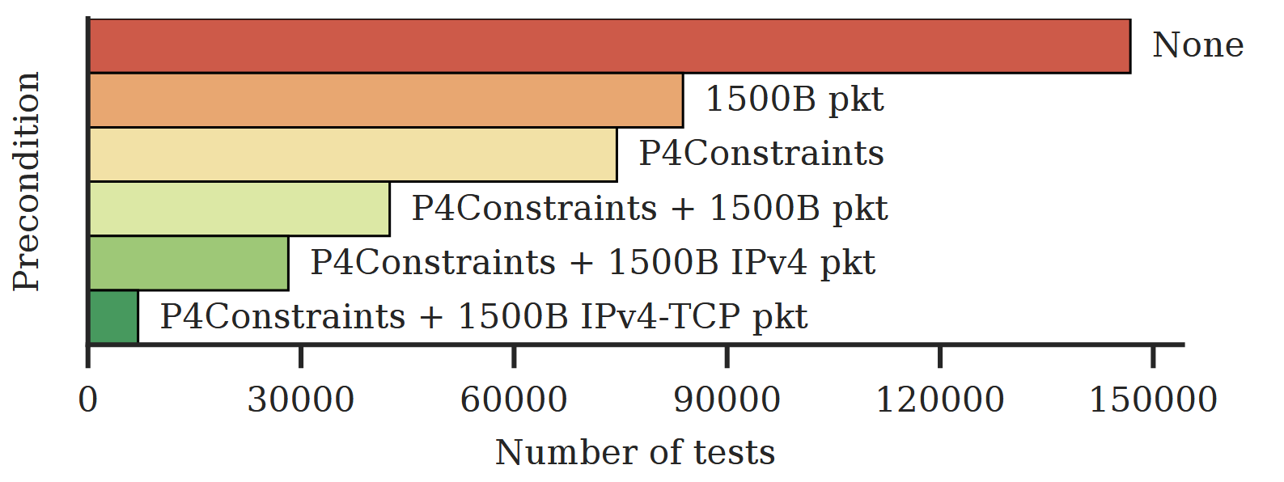
Using Preconditions To Generate Targeted Tests
We only want to generate want particular type of tests
For example: “Please only generate tests with IPv4/IPv6/ICMP packets.”
Effects of various preconditions on the number of generated tests.

