Slide 1

Finding Bugs in Compilers for Programmable Packet Processing
Fabian Ruffy, Tao Wang, and Anirudh Sivaraman
p4gauntlet.github.io

Slide 2
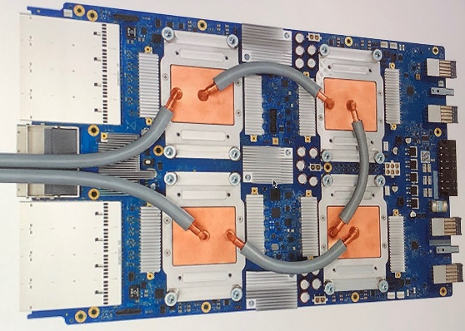



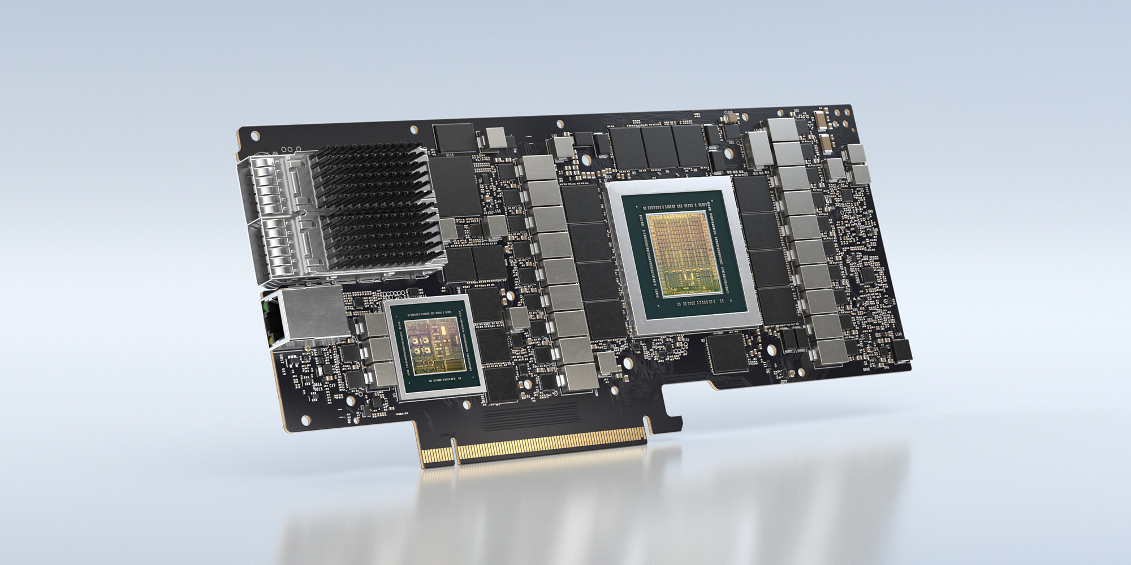


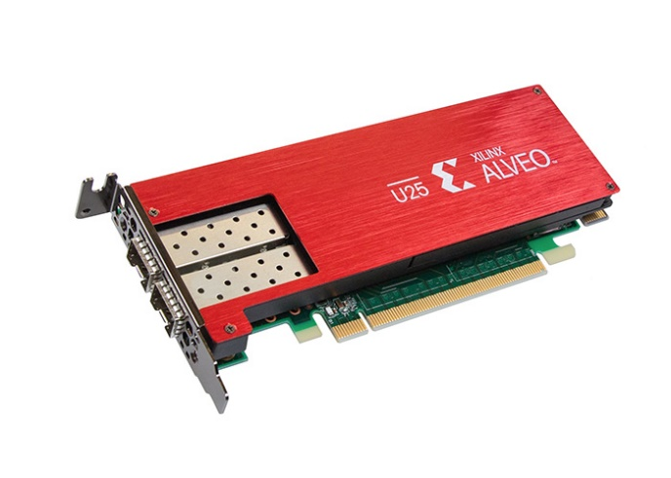
Computation is Moving to Accelerators
Accelerators for machine learning
Google TPU, Intel VPU
Cloud FPGAs for specialized tasks
Microsoft Catapult, Amazon F1
DPUs (Fungible, NVIDIA Bluefield)
Programmable Networks
SmartNICs (Xilinx, Pensando)
Programmable switch chips
(Barefoot, Cisco, Broadcom)

Slide 3
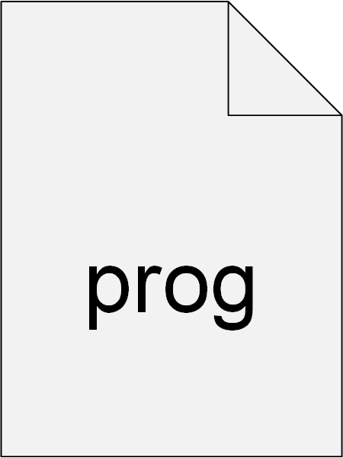


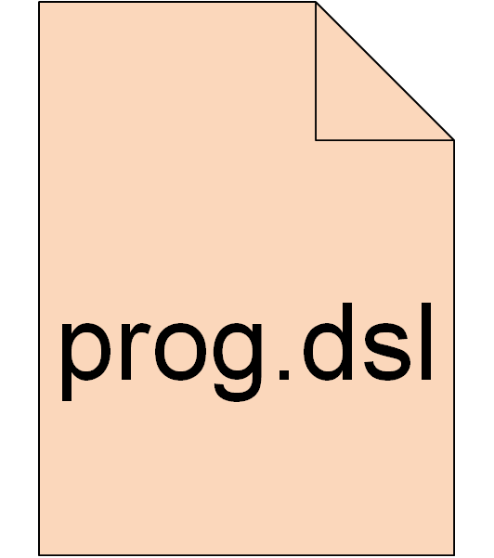

Accelerators and Domain-Specific Languages
Force the developer to “think” in accelerator-specific abstractions
Examples
TensorFlow HLO for deep learning models
P4/NPL for packet processing
DSLs are often constrained and not Turing-complete!
Consequence

Slide 4


Compilers and Domain-Specific Languages
DSLs typically require a custom compiler, which…
enforces the restrictions for the target accelerator
translates high-level spec into device-specific instructions
applies domain-specific optimizations
Increase in accelerators leads to…
…more domain-specific compilers to deal with

Slide 5



What about Bugs in These Compilers?
Compilers for these DSLs may have bugs
Newer → not as well-tested as general-purpose GCC, LLVM, ICC
Often compile for mission-critical paths → high impact of faults
applies domain-specific optimizations
How do we make sure that these compilers are reliable?

Slide 6



Exploit Constrained DSLs!
Observation: DSLs only need to express restricted functionality
If we constrain our DSL just right we can…
…efficiently apply formal methods
…revive old techniques from compiler and testing literature

Slide 7
Our Work: Bug-finding Techniques for P4₁₆
We describe
How to find bugs in compilers for the P4₁₆ DSL
How we revive old compiler techniques to find bugs
Gauntlet, our tool suite that finds bugs in P4₁₆ compilers

Slide 8
Broader Takeaways
Designing a DSL well can lead to effective analysis tools
Limiting undefined behavior eases code generation
Restrictions make expressive semantics possible
P4₁₆ is such a semantics-friendly DSL. This helped us...
…identify more than 90 bugs within eight months of testing
…apply translation validation at scale without false positives
…integrate translation validation into the CI pipeline of P4C

Slide 9


What is P4?
DSL for network data planes
Specifies how an incoming packet header is parsed
Allows the implementation of custom network protocols
Open and standardized
Packets
P4 Program
P4
Compiler
Target-specific binary
Programmable
network device

Slide 10
P4: Current Landscape
Back ends
Intel (Barefoot) Tofino, Cisco Silicone One, Xilinx Alveo
Users
Google, Broadcom, Nokia, Orange…
P4₁₆ DSL has a reference compiler: P4C
Has status similar to LLVM/GCC; represents the P4 spec
P4C transforms input → streamlines and optimizes code

Slide 11
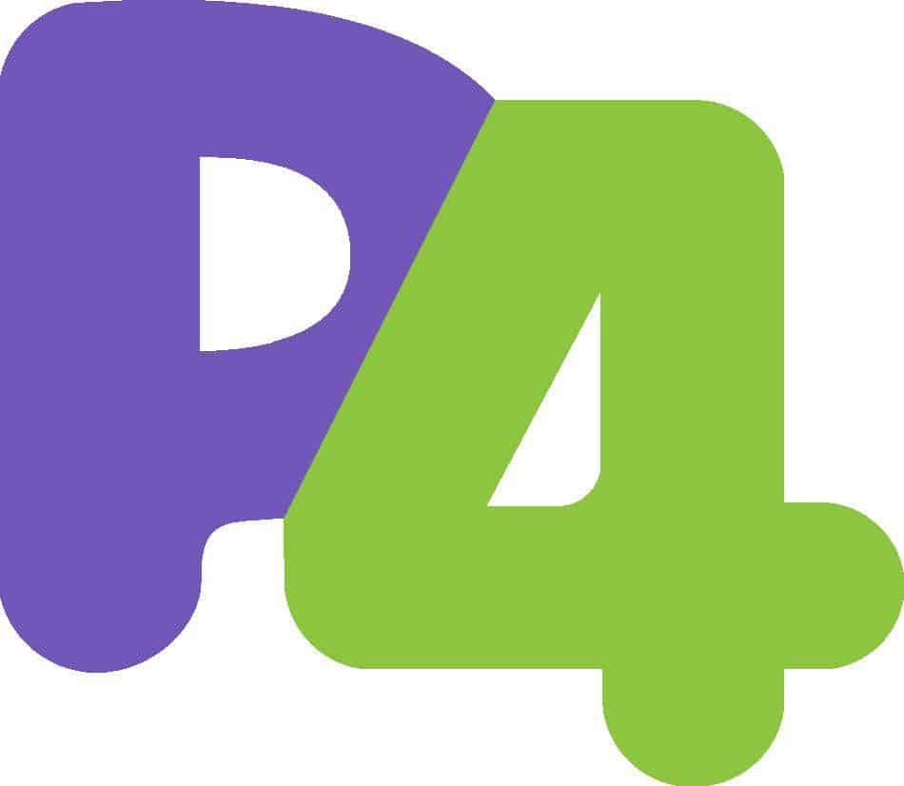
Compiler Context: P4C
IR with target-specific
extensions
Same IR
P4
Program
P4₁₆
Parser
Front End
Mid End
Back End
IR
IR
IR
Target-independent compiler passes
(25+ distinct transformations)
Target-specific compiler passes
IR: Intermediate Representation

Slide 12
Stages of Testing a Compiler
LEVEL
INPUT CLASS
CAN THE COMPILER HANDLE…
Increased Precision
1
Sequence of ASCII characters
…large input sizes?
2
Sequence of words, etc.
…an invalid token?
3
Syntactically correct program
… a missing bracket?
4
Type-correct program
…adding int to a struct?
5
Statically conforming program
… a variable that is not defined?
6
Dynamically conforming program
…transforming expressions?
Differential testing for software., McKeeman, William M., Digital Technical Journal, 1998

Slide 13
Two Types of Bugs
Sequence of ASCII characters
Crash Bug
Sequence of words, white space…
Syntactically correct program
“Obvious” bug
Type-correct program
Program that causes the compiler to exit abnormally
Statically conforming program
Dynamically conforming program
All bugs up to level 5
Miscompilation or “Semantic Bug”
No error raised, but behavior of program is altered
Typically caused by misbehaving compiler passes
Level 6

Slide 14
How to Crash the Compiler?
Sequence of ASCII characters
Random programs
Sequence of words, white space…
Syntactically correct program
We target level 5
Type-correct program
Statically conforming program
Generate random programs that are valid
Dynamically conforming program
Identify programs that cause a non-zero exit code
Could also be a program that is incorrectly rejected
Bonus: Use the generated programs to find semantic bugs

Slide 15



Handling Semantic Bugs in the Compiler
Compiler
Verification?
Differential
Testing?
Translation
Validation?
Correct?
Proof
Assistant
Equal?
Equal?

Slide 16



Why does Translation Validation Work for P4?
Historically limited because of undecidability
But, P4’s properties are a great fit for formal methods
Language core not Turing-complete
Program-structure provides well-defined state
Input/output and state known at program start
We can compare entire programs!

Slide 17

Model-Based Testing
Cannot use translation validation for closed-source compilers
No access to the IR
Output binary obfuscated and semantics unknown
Idea: Reuse program semantics to infer input and output
Requires end-to-end test framework
Input/output pairs are computed based on program branches
test1.stf
Pass_1.p4
Pass_1.p4
Pass_1.p4

Slide 18

The Gauntlet Framework for P4
Toolbox of testing software
Random code generator
Interpreter that converts P4₁₆ to Z3
Translation validation and testing pipeline
Three concrete techniques for finding bugs
  Random code generation to find crash bugs
  Translation validation to identify semantic bugs
  Bonus: Model-based testing for closed-source compilers

Slide 19
Normalized Z3 Semantics: Example
P4 Program
Semantic Representation
struct Hdr {bit<48> mac_dst;
bit<48> mac_src;
bit<16> eth_type; }
control in(inout Hdr hdr, in bit<8> flag) {
main {
if (flag = 0) {
hdr.eth_type = Ox800; // IPv4
} else {
hdr.eth_type = 0x86DD; // IPv6
}
}
}
Symbolic input: hdr, flag
Symbolic output: hdr_out
hdr_out = if (flag == 0):
Hdr(hdr.mac_dst,
hdr.mac_src,
0x800)
otherwise:
Hdr(hdr.mac_dst,
hdr.mac_src,
0x86DD)

Slide 20
Generating a Random Program for P4C
Program generator modelled after Csmith
But does not avoid undefined behavior → Simpler
“Grow” the AST by picking from legal P4₁₆ expressions
Code generation is guided by P4₁₆ specification
A correctly rejected, generated program is a bug in our tool
Small fragments of the language sufficient to detect bugs
Branching is limited → Performance not a concern

Slide 21




The Gauntlet Validation Workflow
Produce random
P4 program
Emit P4 code
after each pass
Convert P4
to Z3
Check
Z3 equality
Generator
P4C
Gauntlet
Gauntlet
OK
pass1.p4
Pass_1.p4
Pass_1.p4
Equal?
Pass_1.p4
Non-zero
exit code
Semantic Bug
Crash Bug

Slide 22




Bonus: Model-Based Testing
Produce random
P4 program
Generator
Convert P4
to Z3
Generate tests
and
expected output
OK
test1.stf
Pass_1.p4
Pass_1.p4
Pass_1.p4
Equal?
Compile
Load
into device
Record output
Non-zero
exit code
Semantic Bug
Crash Bug

Slide 23
Results
Found 96 compiler bugs in 8 months
62 compiler crashes (25/62 in the compiler for the Tofino network chip)
34 semantic bugs (7/34 in the compiler for the Tofino network chip)
Some observations
Crashes were largely caused by an assertion firing
Handling side-effects correctly is difficult
Resulted in 6 specification changes

Slide 24
Future Work
Develop semantics for instruction set architectures
Extend translation validation to back ends
Ensure correctness during the entire compilation process
Detect other classes of compiler bugs
Identify when an optimization should have been applied
Identify compiler passes negatively affecting performance
Again repurpose techniques from compiler testing literature

Slide 25
Summary
A well-designed device DSL can lead to effective analysis tools
P4 is a semantics-friendly DSL, which helped us build Gauntlet
With Gauntlet we were able to...
…apply translation validation at scale without false positives
…identify more than 90 bugs within eight months of testing
…integrate translation validation into the CI pipeline of P4C
Contact
Project Repository
Thank you
for listening!
Fabian Ruffy (fruffy@nyu.edu)
Tao Wang (tw1921@nyu.edu)
Anirudh Sivaraman (anirudh@cs.nyu.edu)
p4gauntlet.github.io

