Slide 1
Exploiting the P4 DSL to Find Bugs in P4 Compilers
Fabian Ruffy, Tao Wang, and Anirudh Sivaraman
p4gauntlet.github.io

Slide 2
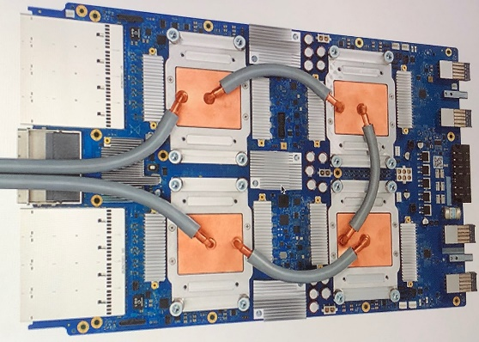
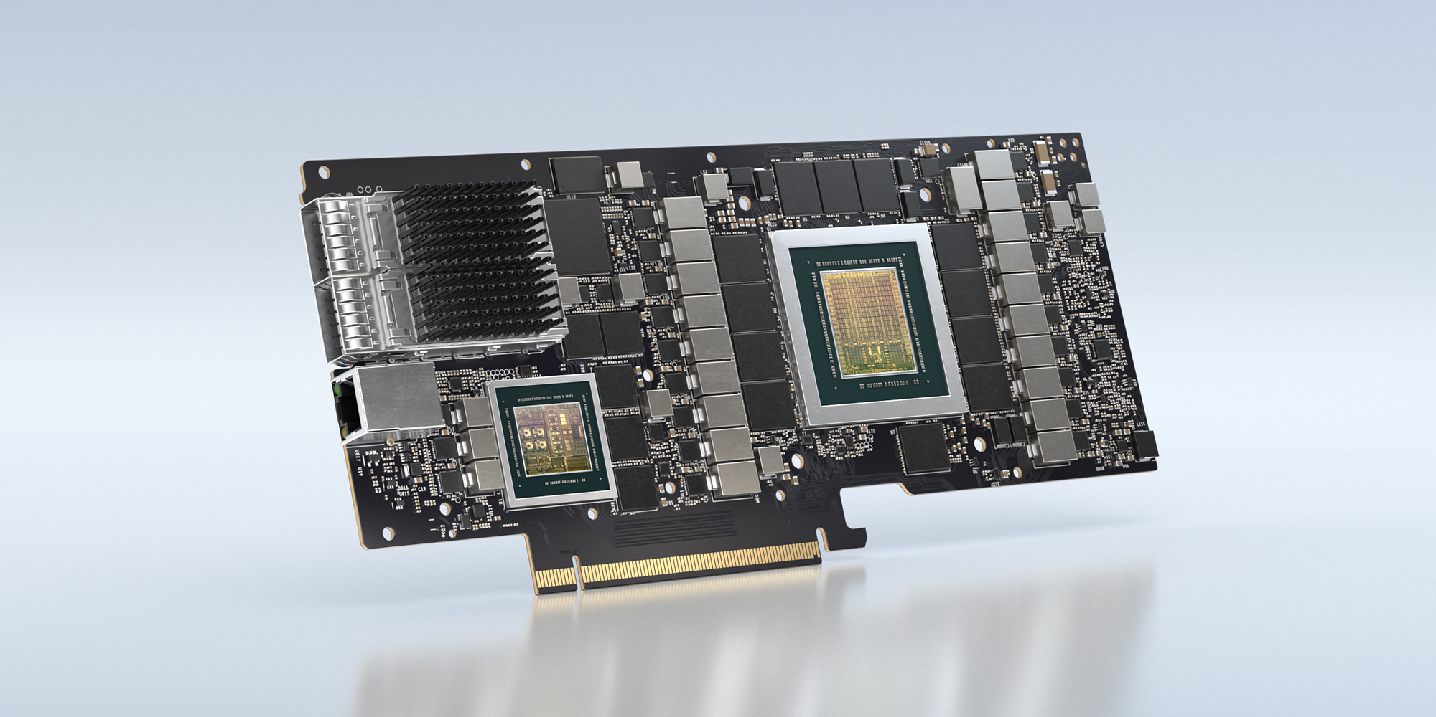
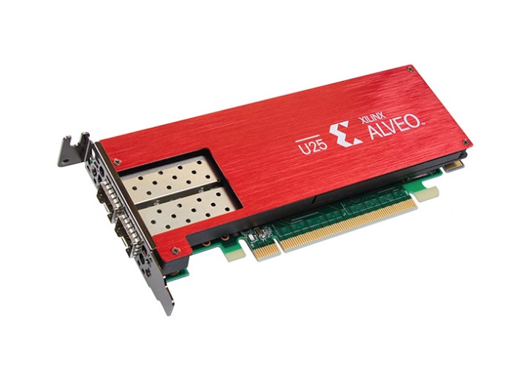
Computation is Moving to Accelerators
Accelerators for machine learning
Google TPU, Intel VPU
Cloud FPGAs for specialized tasks
Microsoft Catapult, Amazon F1
DPUs (Fungible, Intel IPU, NVIDIA Bluefield)
Programmable Networks
SmartNICs (Xilinx, Pensando)
Programmable switch chips (Barefoot, Cisco, Broadcom)

Slide 3
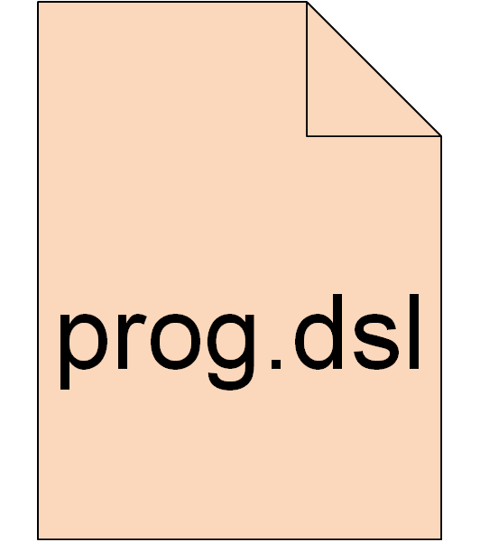
Accelerators and Domain-Specific Languages
Force the developer to “think” in accelerator-specific abstractions
Examples
TensorFlow HLO for deep learning models
P4/NPL for packet processing
DSLs are often constrained and not Turing-complete!
Consequence

Slide 4
Compilers and Domain-Specific Languages
DSLs typically require a custom compiler, which…
enforces the restrictions for the target accelerator
translates high-level spec into device-specific instructions
applies domain-specific optimizations
Increase in accelerators leads to…
…more domain-specific compilers to deal with

Slide 5
What about Bugs in These Compilers?
Compilers for these DSLs may have bugs
Newer → not as well-tested as general-purpose GCC, LLVM, ICC
Often compile for mission-critical paths → high impact of faults
applies domain-specific optimizations
How do we make sure that these compilers are reliable?

Slide 6
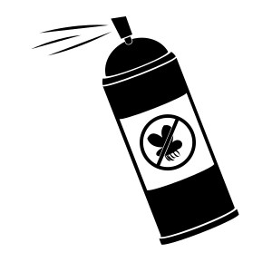
Exploit Constrained DSLs!
Observation: DSLs only need to express restricted functionality
If we constrain our DSL just right we can…
…efficiently apply formal methods
…revive old techniques from compiler and testing literature

Slide 7
Our Work: Bug-Finding Techniques for P4₁₆
This talk is about
How to find bugs in compilers for the P4₁₆ DSL
How we revive old compiler techniques to find bugs
Gauntlet, our tool suite that finds bugs in P4₁₆ compilers

Slide 8
Broader Takeaways
Designing a DSL well can lead to effective analysis tools
Limiting undefined behavior eases random program generation
Restrictions make expressive semantics possible
P4₁₆ is such a semantics-friendly DSL. This helped us...
…identify more than 90 bugs within eight months of testing
…apply translation validation at scale without false positives
…integrate translation validation into the CI pipeline of P4C

Slide 9
P4: Current Landscape
Parser
Front end
Mid End
Back end
Back ends
Intel Tofino, Cisco Silicone One, Xilinx Alveo
Users
Google, Broadcom, Alibaba, Ericsson, …
P4₁₆ DSL has a reference compiler: P4C
Has status similar to LLVM/GCC; represents the P4 spec
P4C transforms input → streamlines and optimizes code
What about bugs in these transformations?

Slide 10
Two Types of Bugs
Parser
Front end
Mid End
Back end
Crash Bug
“Obvious” bug
Program that causes the compiler to exit abnormally
Miscompilation or “Semantic Bug”
No error raised, but behavior of program is altered
Typically caused by misbehaving compiler passes

Slide 11
How to Crash the Compiler?
Random programs
Generate random programs that are valid
Easier as undefined behavior is well-restricted in P4
Identify programs that cause a non-zero exit code
Could also be a program that is incorrectly rejected
Bonus: Use the generated programs to find semantic bugs

Slide 12
How to Find Semantic Bugs
We use translation validation
Historically limited because of undecidability
But, P4’s properties are a great fit for formal methods
Language core not Turing-complete
Program-structure provides well-defined state
Input/output and state known at program start
We can semantically compare entire programs!

Slide 13
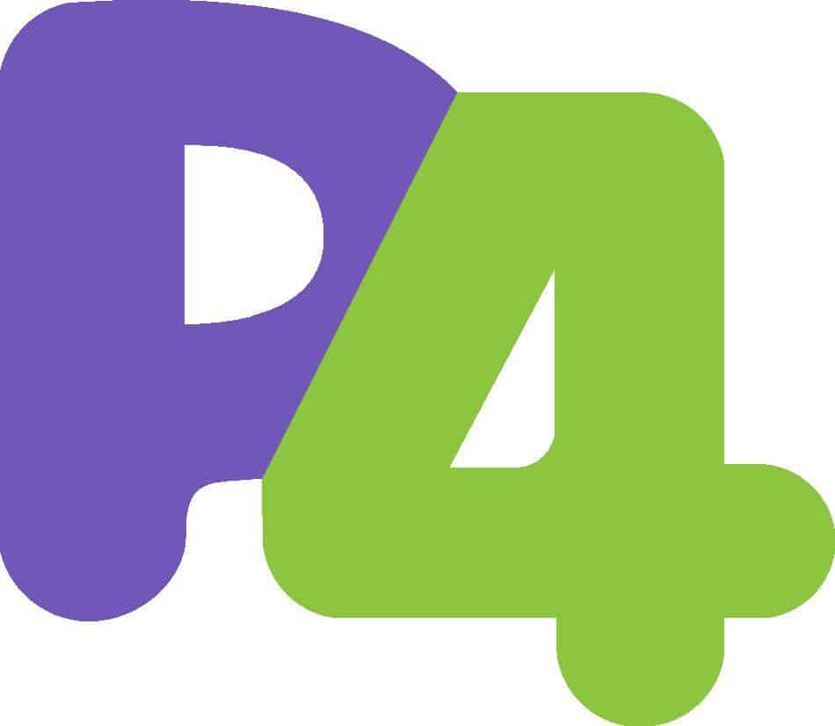
The Gauntlet Validation Workflow
Produce random
P4 program
Emit P4 code
after each pass
Convert P4
to Z3
Check
Z3 equality
Generator
P4C
Gauntlet
Gauntlet
OK
pass1.p4
Pass_1.p4
Pass_1.p4
Equal?
Pass_1.p4
Non-zero
exit code
Semantic Bug
Crash Bug

Slide 14
Results
Found 102 compiler bugs
64 compiler crashes (25/64 in the compiler for the Tofino network chip)
38 semantic bugs (7/38 in the compiler for the Tofino network chip)
Bonus: Used model-based testing to find bugs in the closed-source Tofino compiler
Triggered 6 P4 specification changes

Slide 15
Future Work
Develop semantics for instruction set architectures (ISAs)
Extend translation validation to back ends
Ensure correctness during the entire compilation process
Detect other classes of compiler bugs
Identify when an optimization should have been applied
Identify compiler passes that negatively affect performance or resource usage
Once again, repurpose techniques from compiler testing literature

Slide 16
Summary
A well-designed device DSL can lead to effective analysis tools
P4 is a semantics-friendly DSL, which helped us build Gauntlet
With Gauntlet we were able to...
…apply translation validation at scale without false positives
…identify more than 90 bugs within eight months of testing
…integrate translation validation into the CI pipeline of P4C
Contact
Project Repository
Thank you for listening!
Fabian Ruffy (fruffy@nyu.edu) Tao Wang (tw1921@nyu.edu)
Anirudh Sivaraman (anirudh@cs.nyu.edu)
p4gauntlet.github.io

